Slide 1
AASHTOWARE DATA INTEGRATION FRAMEWORK Phase 2 – Session 1
Kickoff Meeting
September 24th, 2020

Slide 2
AGENDA
1
Sessions’ Format General Overview
2
Lab Portal Introduction
3
Collaboration Channels
4
Swagger Tooling & OpenAPI 3.0 Standard
5
Lab Exercise 1
6
Next Session Look-Ahead
7
Q&A, Close Out
Notes:
Add QA Point after Lab Ex

Slide 3
Today’s Session will be Recorded

Slide 4
Sessions’ Format General Overview

Slide 5
Phase 2 Review Workgroup Sessions
Sessions are conducted every month
API Design Progress, Priorities, and Planning
Collaborative discussions around usage
Hands-on exercises for demonstration
Interactive and accessible references
Session content will be added to the Lab Portal
Notes:
Disclose recording -

Slide 6
Lab (Portal) Introduction

Slide 7
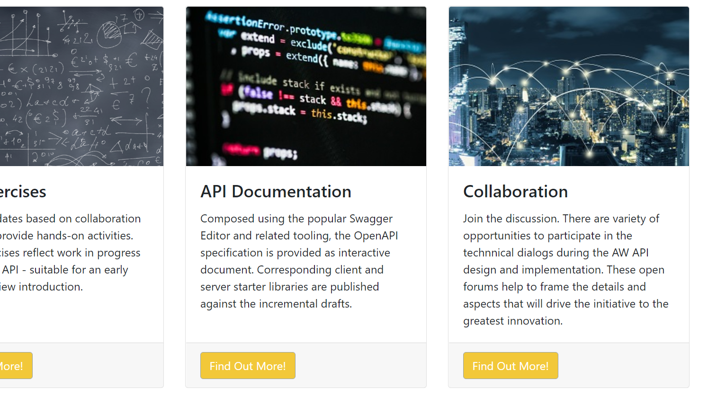
AASHTOWare Data Lab
Notes:
Show lab portal

Slide 8
Lab Access – Registration, Content Access
Data Lab and resources’ access will be controlled
Existing AASHTOWare credentials are your sign-in
New users register with AASHTOWare from the Lab
Once approved, permissions are role-based
This is a work in progress
Notes:
Technical highlights of credentials’ reuse, then cont with demo: managed by AASHTO(Ware)
Emphasize WIP

Slide 9
Lab Exercises
Monthly updates with complete samples
Incorporation of collaboration discussion topics
Intended to reflect API Draft progress
Part of the hands-on virtual walkthroughs
Accessible from the Data Lab for self-paced inspection
Organized to match implementation and usage areas
Notes:
Describe – show examples, prelude discussion: prior to the prelim Address organization of exercises & *purpose*
Access, management – for later usage

Slide 10
API Documentation
Official technical documentation of the API (drafts)
An interactive reference resource
“Offline” downloads suitable for conventional retention
Server Code-Generated scaffolding for implementation
Client SDK starting points for API usage
Formal versioning corresponding to draft revision(s)
Notes:
Reference to TOC in addition to contents

Slide 11
Collaboration
“Public Square” forum through use of MS Teams
Participants are invited to AW API topic channels
Simple and user-friendly (better than email) discussion area
Always-On means to keep momentum on insights
Focused to match the project plan outline guidance
Best means to highlight implementation context
Best means to highlight practical real-world usage
THIS IS WHERE THE MAGIC HAPPENS
Alignment between product offerings, communication
Notes:
Goals –
Emphasize project plan
Hit implementation consequences
Framework | Blueprint
Encourage a vested interest and contribution
Quantify need and impact of input
Leverage align efforts to existing (product, module – roadmap: Bridge & Project)

Slide 12
Collaboration Channels

Slide 13
Monthly Review Sessions
What's New: Status Summary on API Design Progress
Show and Tell on Lab Updates
Recap and Commentary on Previous Session
Lab Exercise(s)
Next Session Look-Ahead
Q&A

Slide 14
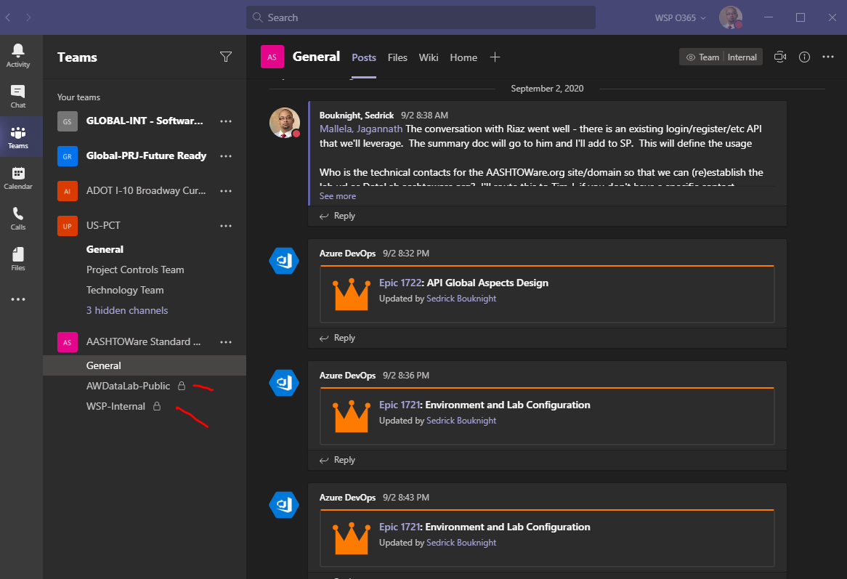
Microsoft Teams
Remote collaboration across organizations
“Tag” individuals to direct context
Simplified conversation forum
Eliminate email noise
Stay in the loop
Notes:
Access teams with guest account

Slide 15
Use of Swagger Tooling for OpenAPI 3.0 Standard

Slide 16
What is the OpenAPI 3.0 Standard
Web-centric stylistic technology architecture
Strives to achieve an information resource framework
Based on the goal tenets of:
Performance
Scalability
Simplicity
Ability to Modify (adapt to changing needs)
Visibility (discovery for use)
Portability
Reliable
A self-descriptive information processing definition
Technology platform, code language indifferent
Robust, flexible, foundational mechanism for data exchange

Slide 17
The Big Picture
API Design
API Implementation
API Use

Slide 18
API Design Goals
Developer Experience (DX)
What is an Implementation
Common Concerns
API Security
API Versioning
AASHTOWare Focus

Slide 19
Swagger Authoring, Tooling
Swagger Editor/Hub is an authoring and composition suite used in the design of OpenAPI artifacts
Cloud-based tool that generates a variety of supporting exports from code to technical documents
Used to establish and then enforced design conventions in API formulation
A professional-caliber technical design tool that supports the phased development of APIs
Based on and originated the OpenAPI standards requirements
Notes:
Walk through the Swagger Hub Code Editor and Documents’ view

Slide 20
Lab Exercise 1

Slide 21
API Basis, Data Dictionary Example
Data Dictionary
Illustration and Introduction Purpose (only)
Design | Implementation | (Multiple) Uses
Swagger Composition
Artifact Generation
Implementation Starter(s)
Additional Considerations

Slide 22
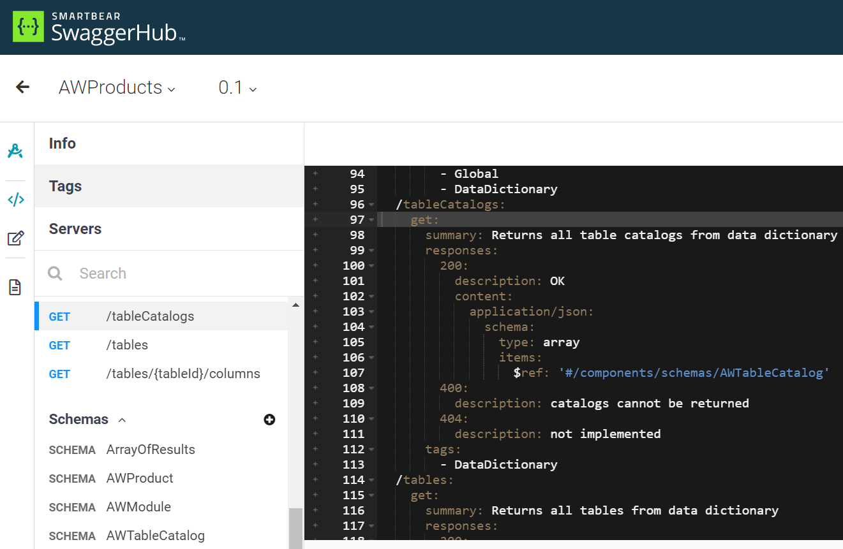
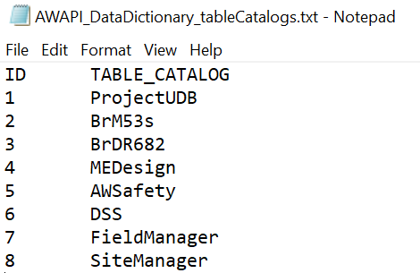
Download Table Catalogs to Text File
Notes:
Visual Studio Code and desktop share

Slide 23
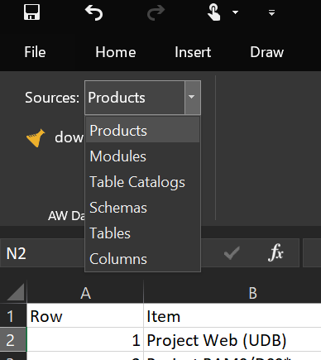
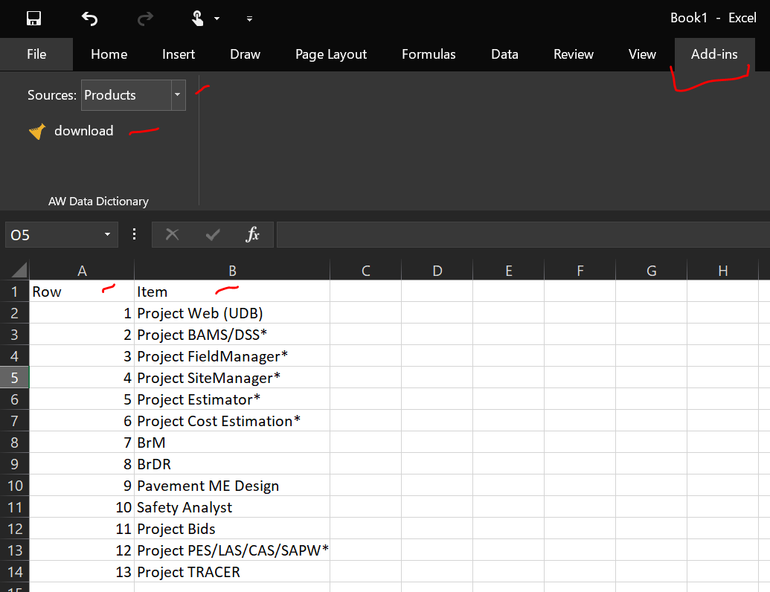
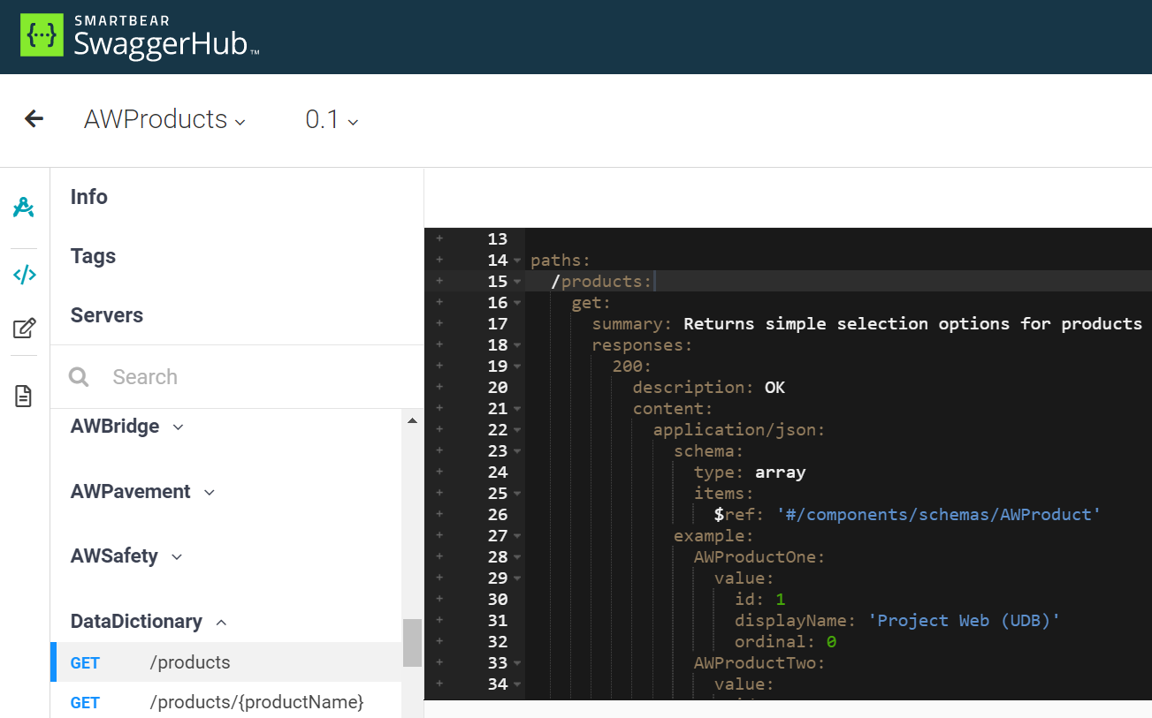
Excel Add-In for AW Data Dictionary Sources
Notes:
Excel data source to restful API

Slide 24
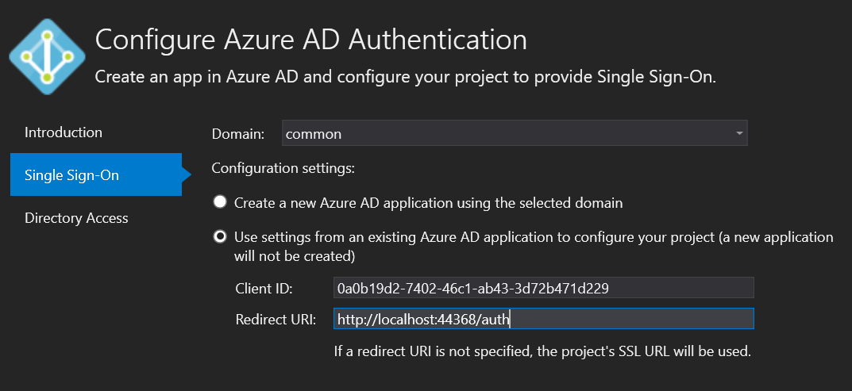
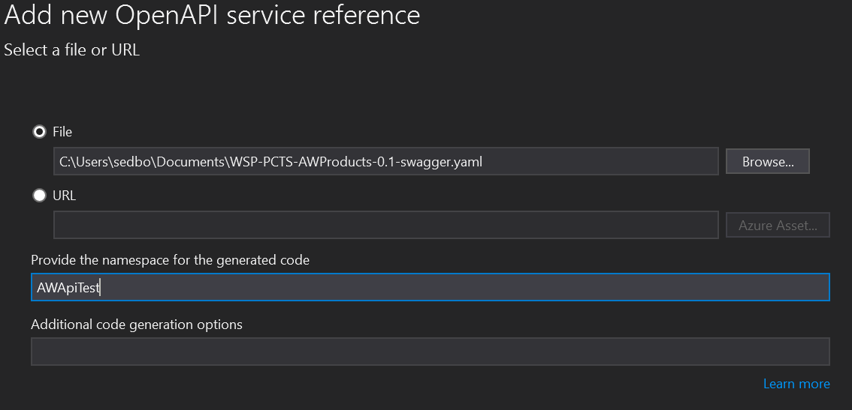
MS Office 365 Authentication (OpenID)
Notes:
MS Identity SSO “current user” echo

Slide 25
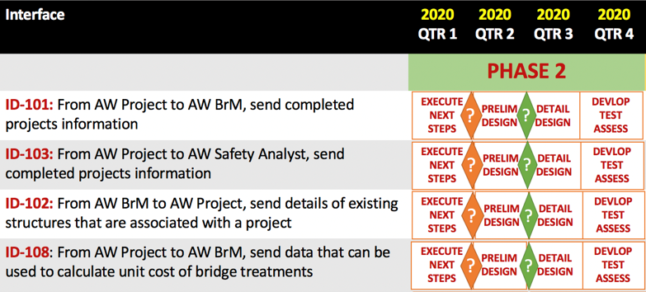
AASHTOWare API “In Action” Prelim
API Routines by Product Modules
Functional Organization
Referencing shared/global components
Representative Scenarios Between Products
Roadmap Sample Takeaways
From Phase 1 Conclusions

Slide 26
Session 2 Look-Ahead
Notes:
Read-Only overlapping scenarios “common denominator” from top 17

Slide 27
Highlights
Example Scenario Breakout
Send Completed Projects from AW Project to AW BrM
Isolating the scenario goal
Translating the goal to the REST API
Data: Parameters | Response Payload | Data Dictionary Ref
Nuance, Balance, Pollution, Deliberate Exceptions
Flavor of the Month: Vanilla (Plain, Sugar-Free)
Determining Design Dependencies
Shared Components
Shared Concerns

Slide 28
Questions & Answers

