Slide 1
AASHTOWARE DATA INTEGRATION FRAMEWORK Phase 2 – Session 2
Review Session
November 5th, 2020

Slide 2
AGENDA
1
Introduction & Session 1 Recap
2
Organizing the Foundation
3
Establishing a Secure API Design
4
What is a Goal? – How it all comes together
5
Lab Exercise 2: Completed Projects, AW Project → AW BrM
6
Next Session Look-Ahead
7
Q&A, Close Out

Slide 3
Today’s Session will be Recorded

Slide 4
Session 1 Recap

Slide 5
Session 1 Takeaways
Sessions are conducted periodically for status reporting, collaboration, and functional ‘show & tell’
The Virtual Data Lab and Portal resources were introduced
The groundwork for technical discussions and insight exchanges have been set
First technical introduction to the OpenAPI Standard and the authoring design suites
Design
Implementation
Use
Conclusions and deliverables from Phase 1 kickstart the Phase 2 effort
API Draft 0.1 Walkthrough and Lab Exercise

Slide 6
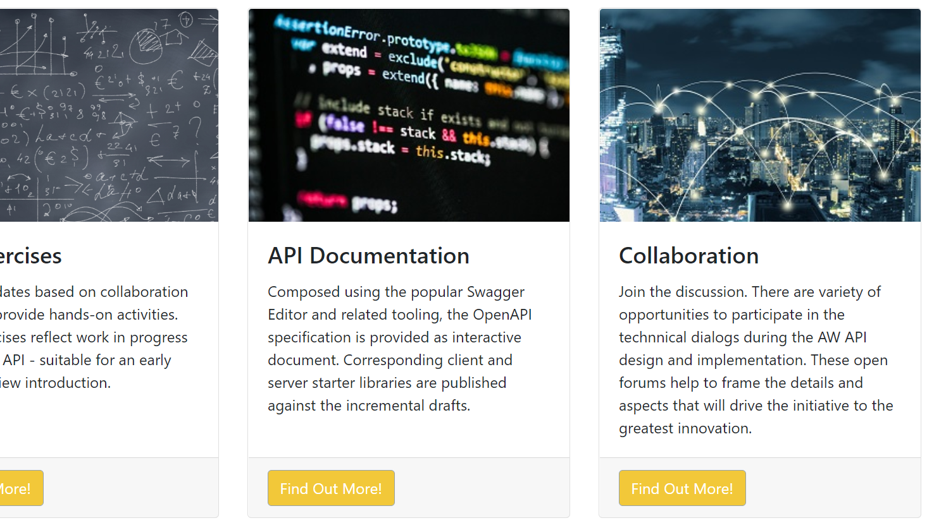
AASHTOWare Data Lab DataLab.AASHTOWare.org
Notes:
Reminder on lab portal address

Slide 7
API Design Fundamentals: Organization

Slide 8
Conventions, Guidelines, Objectives
The OpenAPI Standard provides an extensive framework that creates core conventions
Within the OpenAPI Standard there are patterns/practices that help produce quality designs
The desired capabilities and context establish API foundation
The API Design should simple, straight-forward, and crystal clear
Notes:
Technical highlights of credentials’ reuse, then cont with demo: managed by AASHTO(Ware)
Emphasize WIP

Slide 9
Organization
Design, Implementation, and Usage each contribute influences that are ideally aligned
Separation of concerns between these interests help ensure a robust result
Planning for subsequent extensions/versions is a fact of life
The organization of the API is critical and has a very direct impact
The design must account for the expected API use as well as the logistics of implementation
Uniformity is paramount
Notes:
Describe – show examples, prelude discussion: prior to the prelim Address organization of exercises & *purpose*
Access, management – for later usage

Slide 10
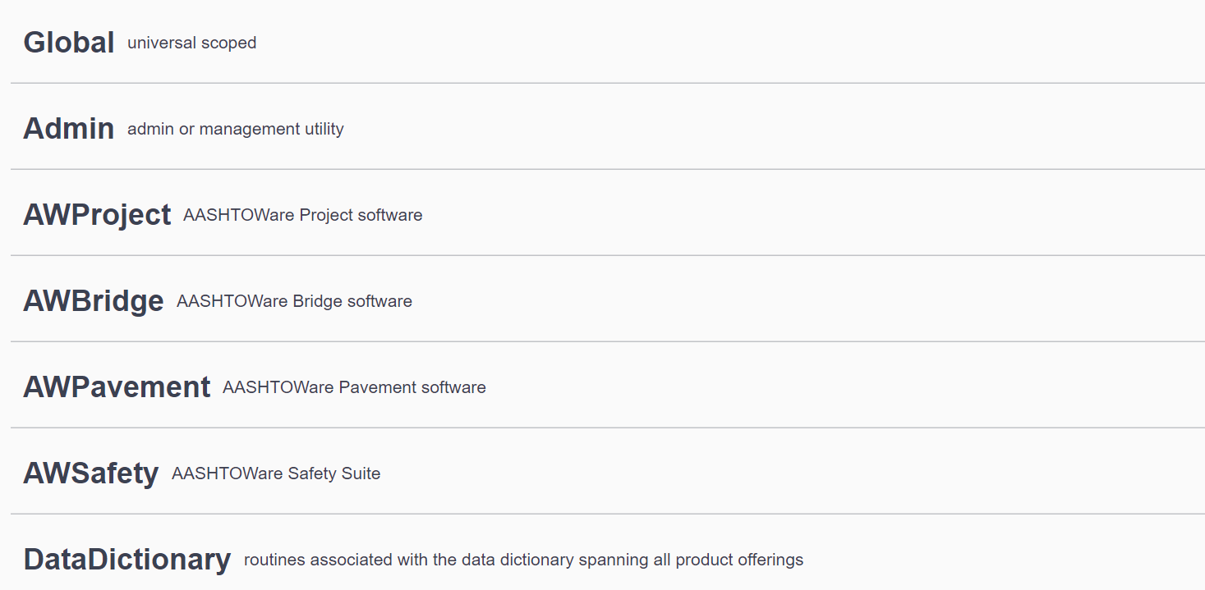
AW API Organization Overview

Slide 11
Distinction by Project, Module
Each AW Product serves as a conceptual container for related functionality, management, or supporting resources
A further segmentation then allows implementation at the most appropriate functional level
The Phase 1 analysis and resulting data dictionary helps to illustrate where these natural boundaries exist.

Slide 12
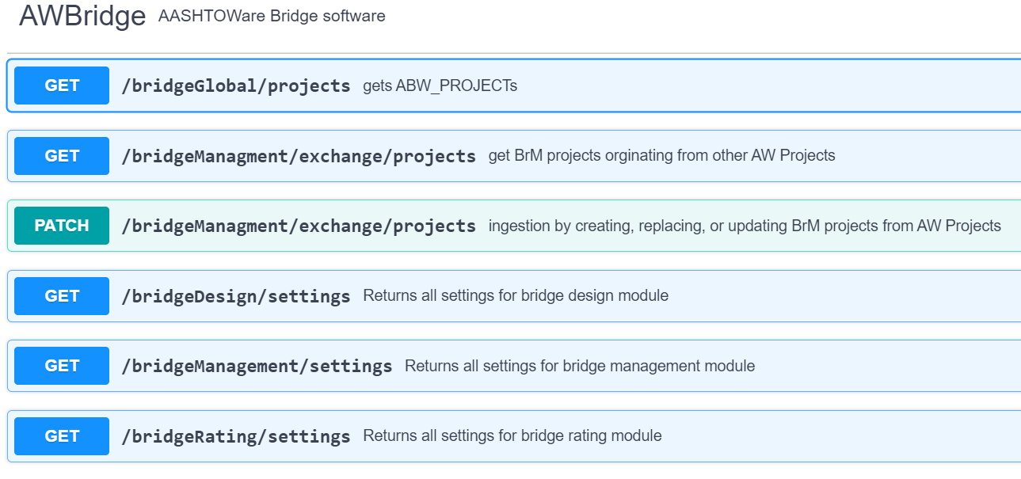
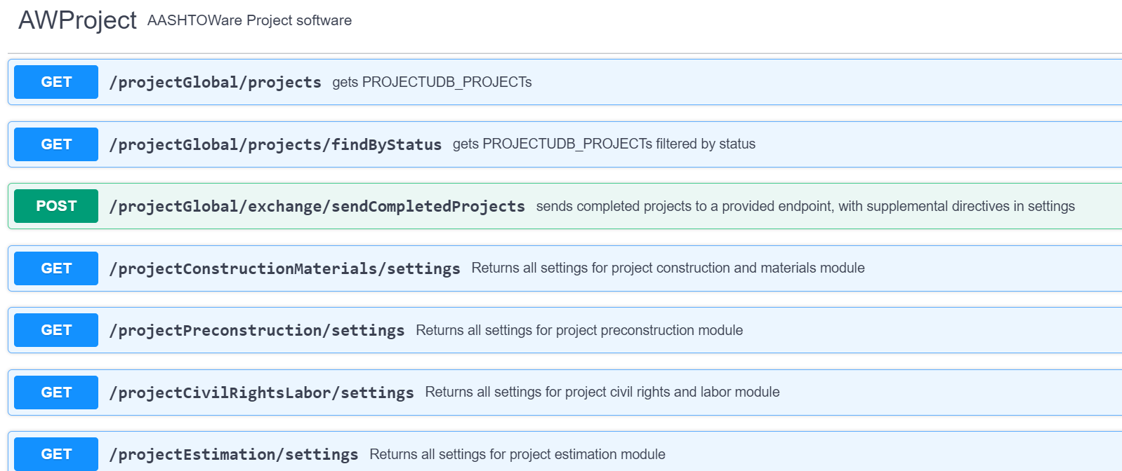
Implementation Occurs by Module

Slide 13
API Security Components

Slide 14
OpenAPI Standard: Authentication | Access
The OpenAPI Standard provides design support for a number of authentication methods
The OpenAPI Standard supports modern enterprise practices for defining access contexts via scopes
Using the authentication and access definitions, API security can be address from inception: ‘Secure by Design’
This does not provide the authentication mechanisms
Scope granularity is important

Slide 15
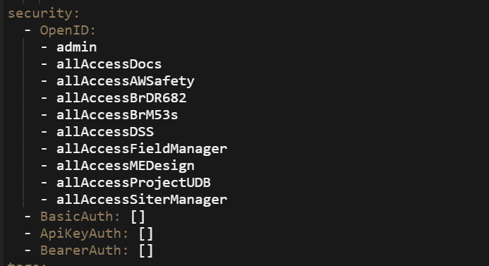
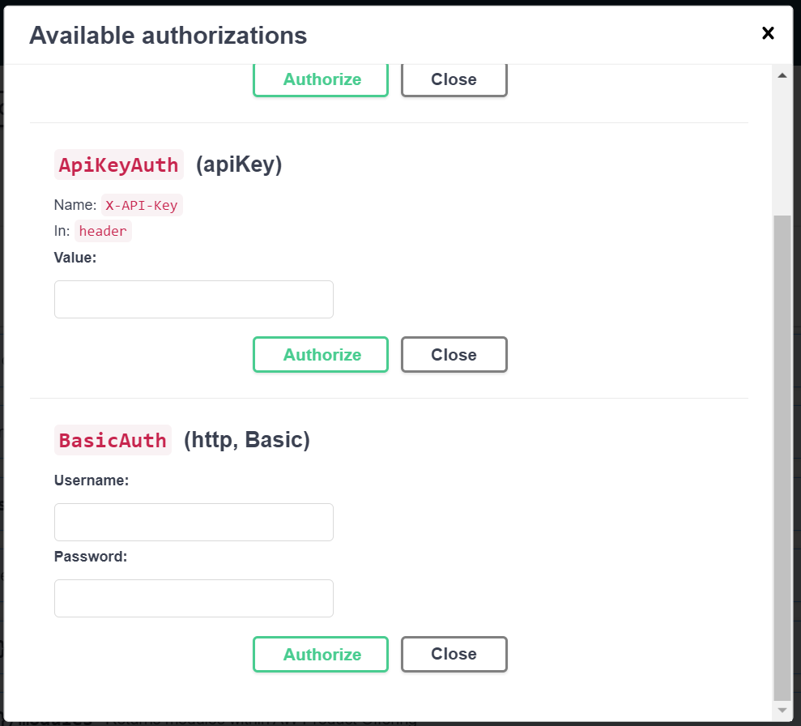
Authentication Schemes

Slide 16
Translating Scenarios to Formal API Goals

Slide 17
What is a Goal
A goal is a design construct defining a capability
In evaluating a functional scenario a number of simple and dependents goals can be isolated
Goals are the basis of the API Design
What are some examples
Get account users
Create profile
Update profile
Query available projects
Update (just) the status on an activity
…

Slide 18
Lab Exercise 2: Phase 1 ‘ID-101’

Slide 19
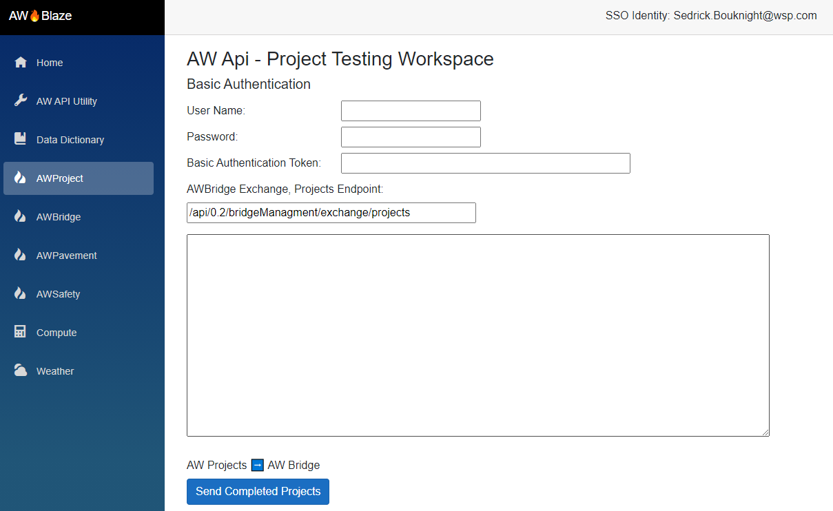
API Draft 0.2
AW Project
AW Bridge

Slide 20
A Quick Flashback…
API Design
API Implementation
API Use

Slide 21
Session 3 Look-Ahead
Notes:
Read-Only overlapping scenarios “common denominator” from top 17

Slide 22
Highlights
Moving Data Dictionary to Schema Ontology
Read Operation Goals from High Impact Scenarios
AW Blaze v1.0
Authentication Sample/Example Implementation
First Scopes’ Definition

Slide 23
Questions & Answers

