Slide 1
AASHTOWARE DATA INTEGRATION FRAMEWORK Phase 2 – Session 3
Review Session
December 17th, 2020

Slide 2
Today’s Session will be Recorded

Slide 3
AGENDA
1
Introduction & Session 2 Recap
2
Structuring, Focusing, Simplifying: Ontology
3
The R in CRUD – High Impact Scenarios, Reading Data
4
Security Redux, the Full Process in Action
5
Lab Exercise 3: 🔥🔥🔥 AW Blaze v1.0 Testing Workbench
6
Next Session Look-Ahead
7
Q&A, Close Out

Slide 4
Session 2 Recap

Slide 5
Session 2 Takeaways
The API Design is Rooted in Practicality, Organized Accordingly
Feature Design is Compromised of Overarching Concerns Combined as well as the Product-Specific Elements
Security is Integral to both the Design and Logical Organization of Capabilities
The OpenAPI Standard Helps to Support Conventions, but Better Practices Must be Defined
Conclusions and deliverables from Phase 1 kickstart the Phase 2 effort
Translating Scenarios, Objectives, and Features to Discrete Aspects is done through “Goals”

Slide 6
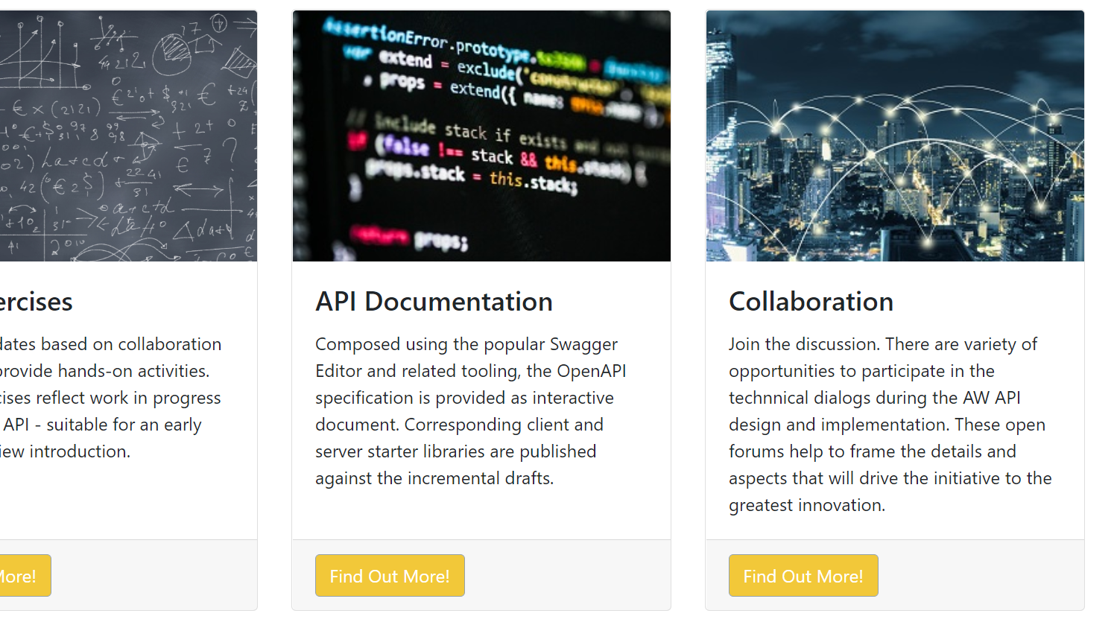
AASHTOWare Data Lab DataLab.AASHTOWare.org
Notes:
Reminder on lab portal address

Slide 7
An Understandable Model: Ontology (Info Sci)

Slide 8
Meaning and Purpose of Ontology
Simply put: The Ontology helps express a “what is” model of a potentially obscure set of data constituents
Clarity, practicality, and utility are the heart the design philosophy
Ontology bridges the descriptive gap in how data may be managed compared to a later form and behavior
A data dictionary and relational model will help start an ontology, but it is not a 100% direct mapping
Ontology serves to conceptually simplify, explain, and structure an area of interest beyond the expertise focus of that interest.

Slide 9
Practical Implications
Don’t Make Me Think – Convention, Consistency, Clarity
A common conceptual approach, and enforcement, dramatically “uncomplicates” understandings
The ontology begins to shape (and facilitate) a repeatable method of design the API’s goals
The threshold to understanding and navigating features is reduced
(Intended) Side Effects: Design, implementation, testing, Prototyping, Consumption
As mentioned before - uniformity is paramount

Slide 10
The User Profile DB Table, Data Dictionary
Column | Data Type
Id | Number
first_name | Text
…
st_addy_ln_1 | Text
Street_Address_Line_2 | Text
City | Text
StateOrProvince | Text
EMILPostal Region Zip Code Value | Text
EMIL Code Type | Number
Mobile Phone | Text
Data Columns Define the “Address”

Slide 11
The Office Directory DB Table, Data Dictionary
Column | Data Type
Id | Guid
BuildingName | Text
OfficeNumber | Text
Address_Line1 | Text
Address_Line2 | Text
City | Text
StateOrProvince | Text
EMILPostal Region Zip Code Value | Text
EMIL Code Type | Number
PhoneNo | Text
Data Columns Define the “Address”

Slide 12
Address – Ontology, API Retrieval: “Read”
User Profile
Office Location
Column | Value
Id | 1911
first_name | Sedrick
…
st_addy_ln_1 | …
Street_Address_Line_2 | …
City | Denver
StateOrProvince | CO
EMILPostal Region Zip Code Value | 80249
EMIL Code Type | 1
Mobile Phone | …
Column | Value
Id | 11510
BuildingName | Starfleet Academy
OfficeNumber | 2375
Address_Line1 | 1 Federation Blvd
Address_Line2 | Campus A
City | Sausalito
StateOrProvince | CA
EMILPostal Region Zip Code Value | 94965
EMIL Code Type | 1
PhoneNo | …

Slide 13
Data Dictionary → API Design Ontology
Data/Schema/Dictionary should not “pollute” the ontology
Even with a partial expertise or understanding, the ontology should be clear
There are a several naming, syntax, and style conventions associate with RESTful practices and the OpenAPI Standard norms
What is the Address EMIL Code, how does it apply to the zip code or postal code?

Slide 14
User Profiles, Offices: A Look at the API
Ontological expectation to get a user profile or office item detail
General convention - https://{root path to an installation}/api/{some version}/{entity name plural}/{id}
Applied to users - https://{root path to an installation}/api/1.0/users/1911
Applied to offices - https://{root path to an installation}/api/1.0/offices/8A07DFD8-E01B-401D-BAD0-E7666F6AB713
Ontological definition of a unified data representation of an address
Column | Data Type(s)
parentId | Number, guid
addressLine1 | Text
addressLine2 | Text
city | Text
stateOrProvince | Text
emilCodeValuePostalRegionZip | Text
emilCodeType | Complex/Object
Standardized Convention
Applied to users: /api/1.0/users/1911/address
Applied to offices: /api/1.0/offices/8A0…713/address
Examples Without Standardized Conventions
{misc path}/GetUserAddress?user_id=1911
{misc path}/GetUser?user_id=1911&select={city,state,zip}

Slide 15
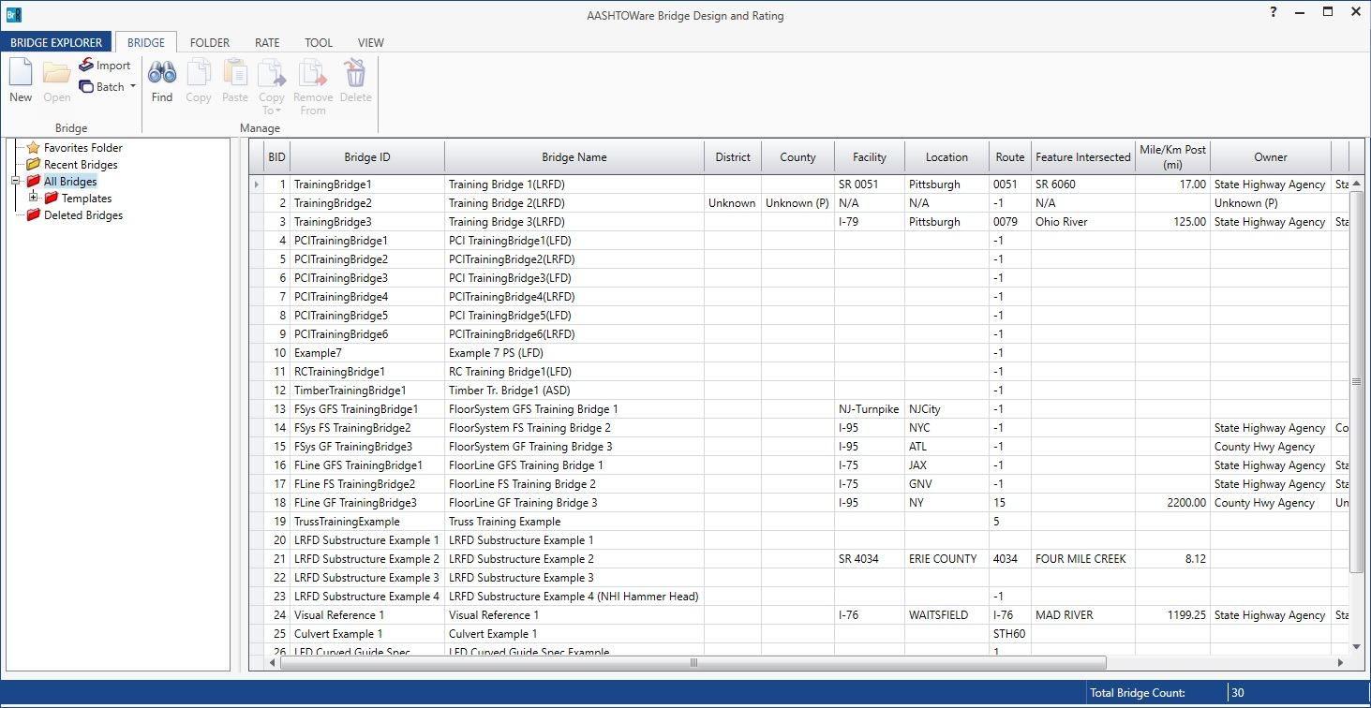
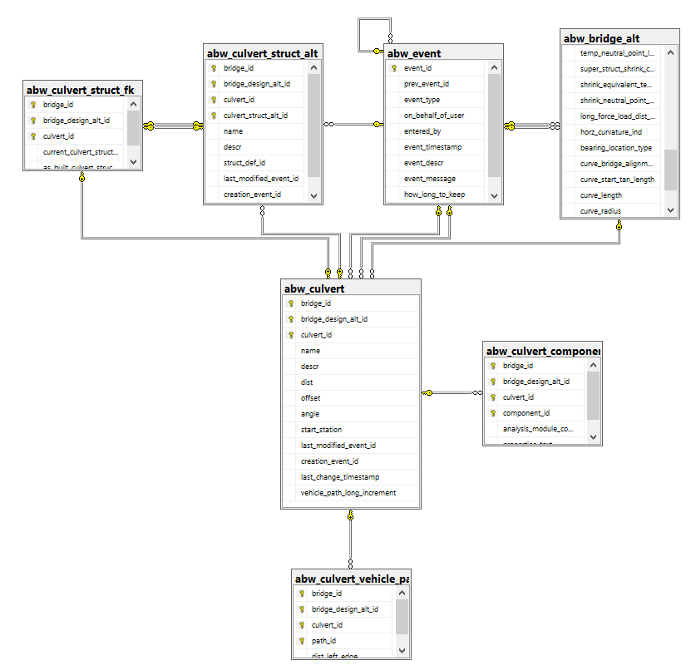
Bridge & Culvert Data Expressions
-Consumption View in App
-Data Schema View in Database

Slide 16
Clarity, Simplicity, Convention – Design Responsibilities
Disambiguation: Terminology may not be clear, or could imply a ‘keyword’ (even in an isolated context)
Timestamp
Ordinal
Index
Intuitive Clarity:
Refrain from abbreviations or short form
documentNumber versus docNo (best: document-number)
Avoid underscoring
Plural|Singular formatting
Adhere to common conventions: discoverability, traverse-ability, cue-inclusion

Slide 17
In Action – Reading Data The R in CRUD

Slide 18
Common Ground – Ontology Influence
The Phase 1 effort produced a data dictionary which is the critical foundation of the ontology
The ontology combined with the OpenAPI standards, patterns, and better practices produce our conventions
The result is a universally consistent approach that is immediately familiar even if the context is foreign
User profiles, directory offices, bridges, culverts – Read methods will be functionally similar

Slide 19
Predictable, Adaptable, Straightforward
It most cases, the data can be treated as a collection of items
For this collection of items, the API design/description must be adequate to retrieve a single item or efficiently traverse the whole set
In referencing a single item, its related items: resolving their details would reflect the same pattern
Paging, sorting, filtering, and selection are fundamentally the same

Slide 20
The OpenApi Standard (RESTful) View
The various simple read/query scenario can be look at from a web address
How does this take shape?
Are there performance considerations?
How are more complex scenarios addressed?
Let’s take a look…

Slide 21
Formats: casing, syntax, methods…
https://datalab.aashtoware.org/api/0.3/tables/17/columns
https://datalab.aashtoware.org/api/0.3/bridgeDesign/bridges
https://datalab.aashtoware.org/api/0.3/bridgeDesign/culverts
https://datalab.aashtoware.org/api/0.3/projectSiteManager/projects
The item’s collection will usually represent a set that must be “paged”
Paging requires additional information related to sorting and page size
Throttling result batches are a potential concern
Both the syntax and method have to be consistent, common parameters
Page Size
Page Index
Sorting by Field(s)
Sort Direction ([+/-])
Max allowed results, max operations per time

Slide 22
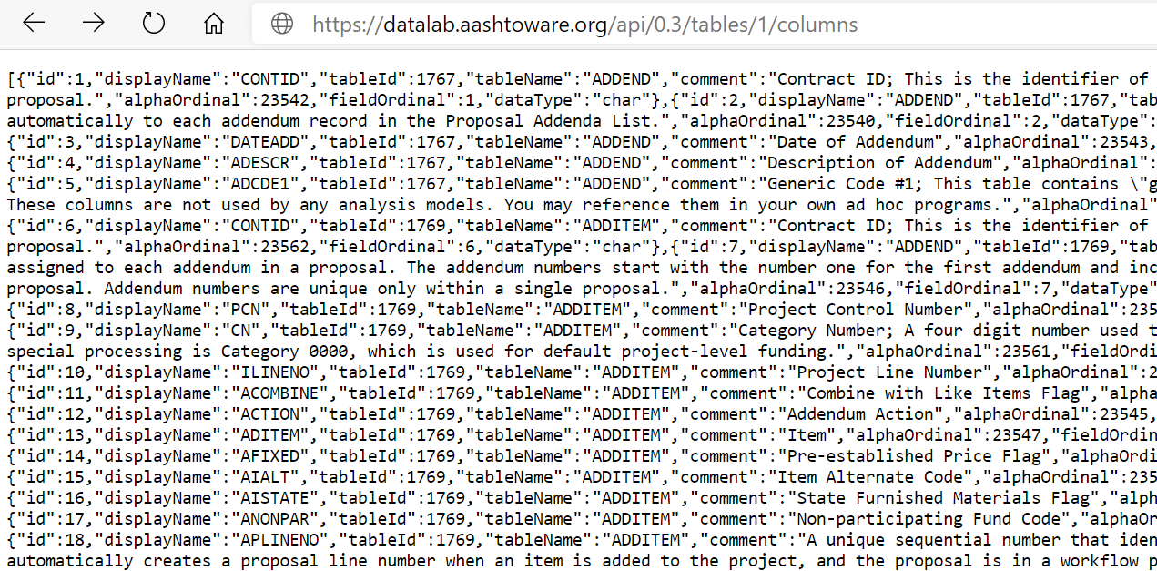
Data Samples:

Slide 23
Revisiting the Big Picture

Slide 24
What is the Process, What are the Steps?
Key scenarios for data and utility are defined (Phase 1)
Data inventory around that focus produces a data dictionary
The scenarios and data components define API “Goals”
Goals are translated into groups of discrete actions
Get Projects
Filter projects by status
Use filtered project as data exchange to import
Goals and granular actions are controlled
Controls start with authentication
Access to goals are defined by scopes to provide permissions context
“Row” level and discrete access control reflect existing rules
The API Design is Implemented
The Implementation is Consumed, Consumers are Managed

Slide 25
Lab Exercise 3: AW🔥Blaze

Slide 26
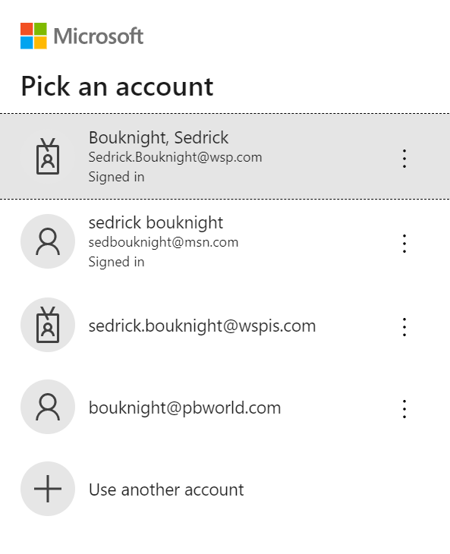
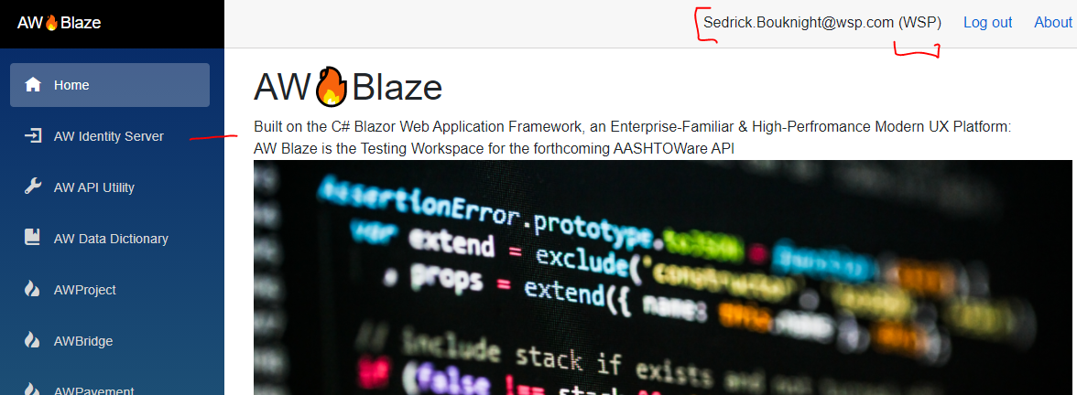
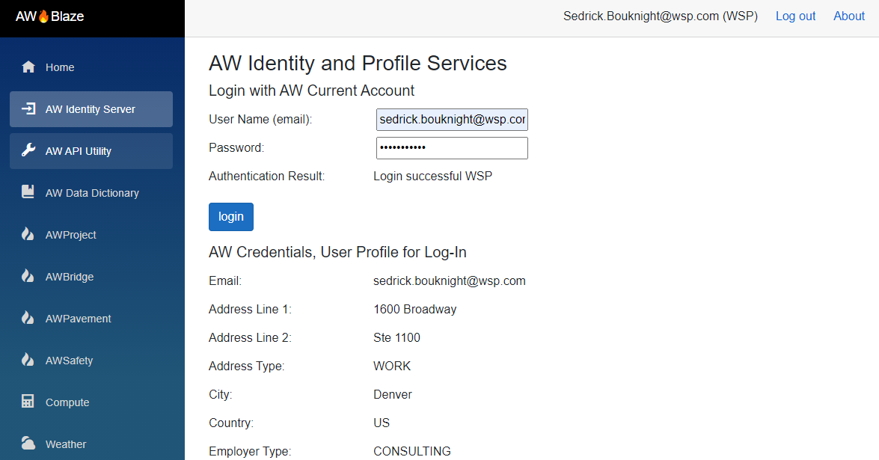
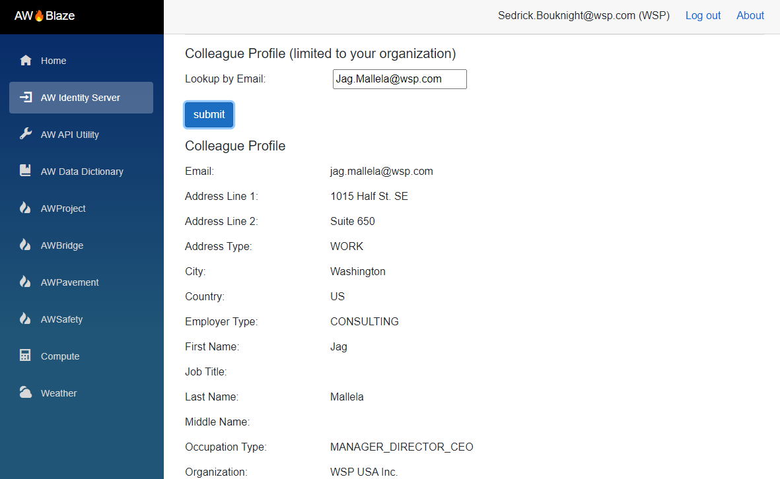
🔥
https://datalab.aashtoware.org/blaze
Notes:
Teaser – and generalization highlight (for technical): alignment – distinguish between guidance and capability (responsibility)

Slide 27
Querying Data from AW Blaze – Live Demo

Slide 28
Session 4 Look-Ahead
Notes:
Read-Only overlapping scenarios “common denominator” from top 17

Slide 29
Highlights
API CRUD, Moving on from the R
Partner|Developer “programs”, API Ecosystem
API Management Portal Concept
High-Impact Scenarios, Inventory and Checklist
“Halftime” Show and 2nd Half Overview

Slide 30
Questions & Answers

