Slide 1
AASHTOWARE DATA INTEGRATION FRAMEWORK Phase 2 – Session 4
Review Session
February 11th, 2021

Slide 2
Today’s Session will be Recorded

Slide 3
AGENDA
1
Introduction & Session 3 Recap
2
Preparing for “Release Version” API Definition
3
Managing Data in the API, Beyond Read-Only Queries
4
High Impact Scenarios API Tour
5
End to End Processes: Governance, Oversight, Management, Extension
6
Lab Exercise 4: High Impact Scenarios, AW Blaze Testing Workbench & Data Dictionary Extraction
7
Preparing for Implementation, v1.0 API Definition Roadmap
8
Next Session Look-Ahead
9
Q&A, Close Out

Slide 4
Session 3 Recap

Slide 5
Session 3 Takeaways
With the volume and breadth of data, structure is necessary
Part of the API design effort is to make specialty data accessible to non-specialists
Querying data in read-only context is the first step in achieving practical utility
A number of cross-cutting concerns must be addressed to ensure a uniform system
Security, diagnostics, platform supports are all part of the design foundation/charter for the API effort
AW🔥Blaze was introduced as the API design testing workbench

Slide 6
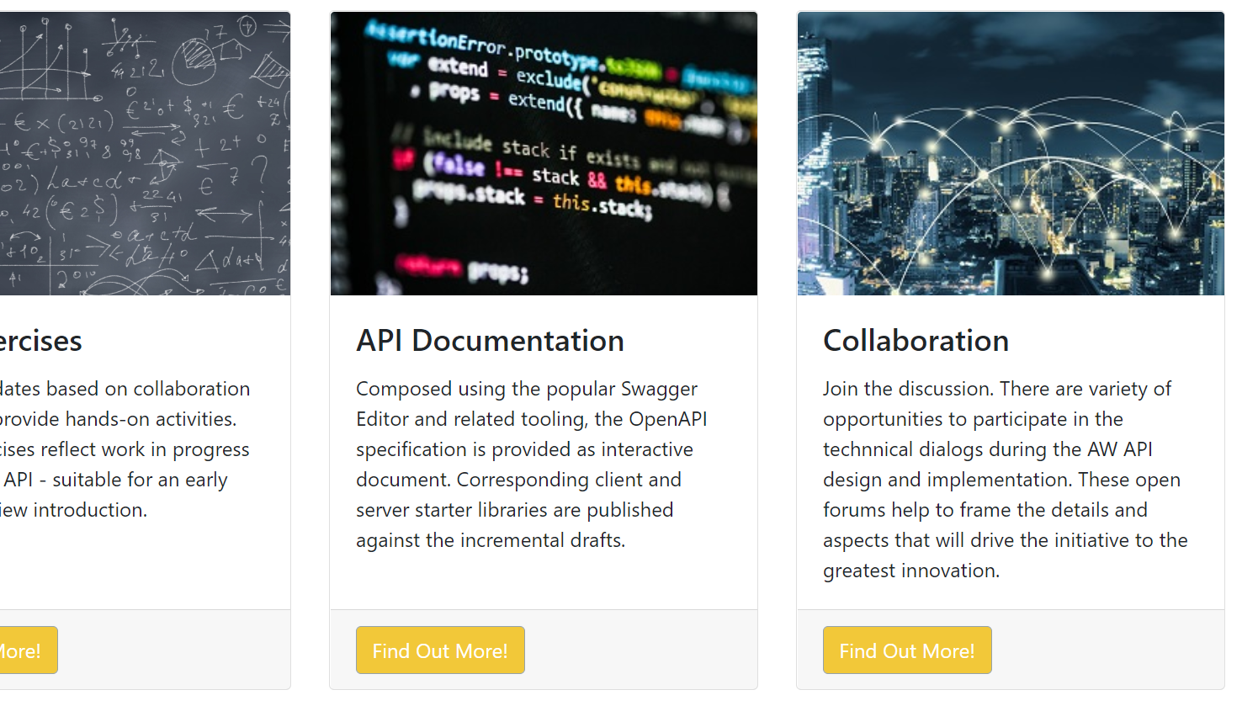
AASHTOWare Data Lab DataLab.AASHTOWare.org
Notes:
Reminder on lab portal address

Slide 7
Version Roadmap: 0.1, … 0.9, 1.0

Slide 8
Retrospective to Date, v0.1, v0.5, v0.9
The initial API draft version started at 0.1
Version 0.5 has been completed
Version 0.9 follows
0.9.1, 0.9.2 … Release version will be 1.0(.x)!
Once the 1.0 release is established Revisions are still expected: 1.1, 1.5, 2.0, 2.1 …
However, once the 1.0 is established, this version will be supported accordingly

Slide 9
What to Expect: Major, Minor, Preview
Post “1.0” updates will reflect the scale and scope of the enhancements in the versioning
Major updates will address capabilities, goals, and feature sets that are fundamentally “new”
Minor updates will complement an existing basis as a revision, extension, or enhancement
Previews are functional “work in progress” drafts that are intended as technical sneak peaks, with conditions

Slide 10
Modifying Data… Additions Updates Deletes
Notes:
Elaborate on the implementation – gate keeping, “don’t panic”, rules still apply

Slide 11
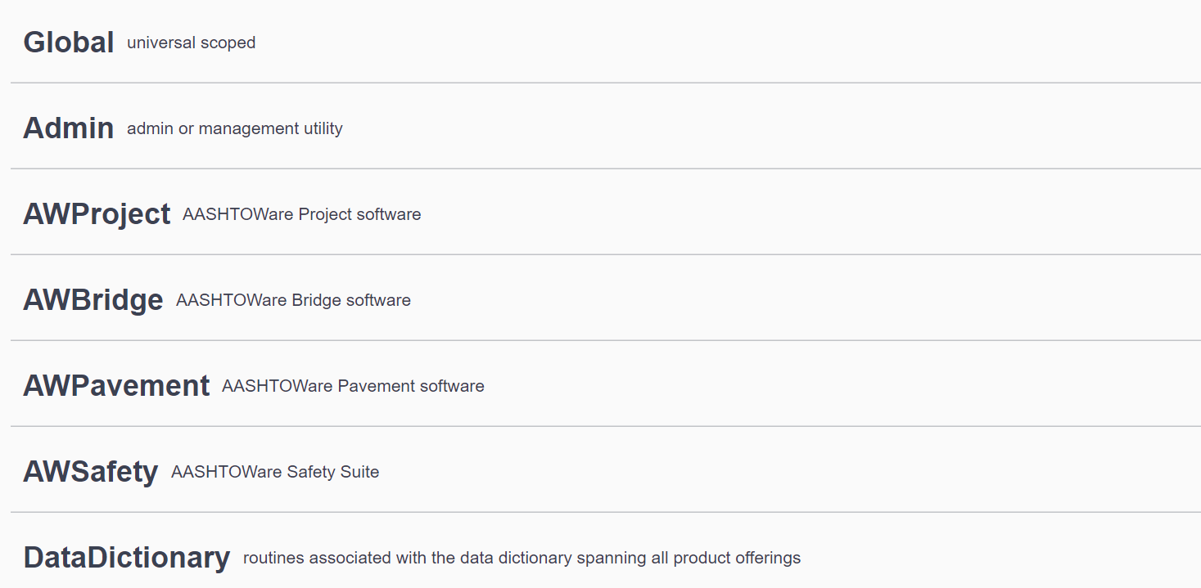
Typical Examples of Queries

Slide 12
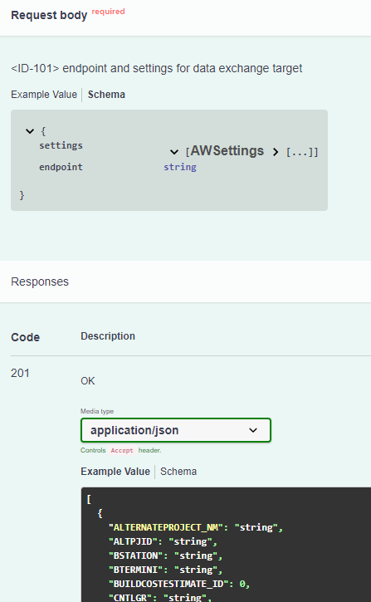
Compared to Modifying the Data

Slide 13
High Impact Scenarios:

Slide 14
Phase 1 Results
AASHTOWare Project & Bridge Integration Activities in Roadmap
AASHTOWare Project & Safety Integration Activities in Roadmap
AW Bridge Products Integration Activities in Roadmap
AASHTOWare Project & Pavement ME Integration Activities in Roadmap

Slide 15
Scenarios Now Available in API Design
Interface ID-101 AW Project to AW BrM Send Completed Project Data
Interface ID-102 AW BrM to AW Project Send Structure Inventory
Interface ID-108 AW Project to AW BrM Send Treatment Unit Cost Data
Interface ID-52 AW BrM to AW BrR Send Bridge Data
Interface ID-51 AW BrM to AW BrD Send Bridge Data
Interface ID-53 AW BrR to AW BrM Send Bridge Ratings
Interface ID-56 AW BridgeLink to AW BrD send Bridge Designs

Slide 16
End to End Process

Slide 17
Returning to the Initial Starting Point…
API Design
API Implementation
API Use

Slide 18
A Closer Look by Phase

Slide 19
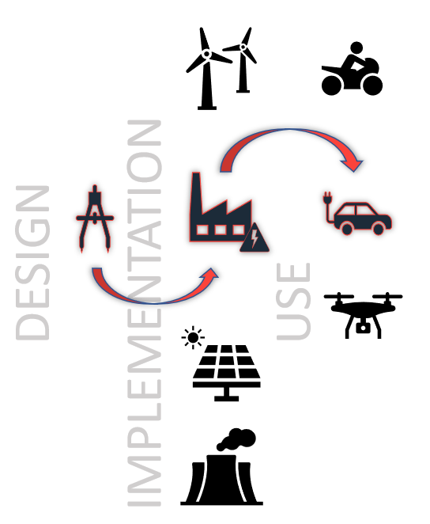
Logistics of the “Live” API
The API Design Updates Continue
Implementation will be Active
Access to the API Usage
Applications/Systems Connect
New Features are Identified
Cycle Repeats

Slide 20
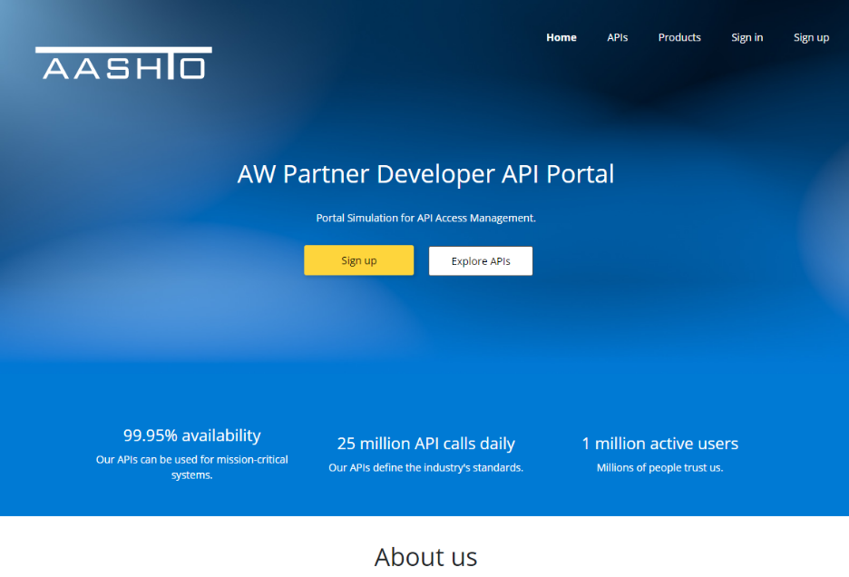
What to Expect: Scenario
From Agency IT Staff to 3rd Party Application Vendors
Partner Program(s)
Training/Reference Resources
Coordination of Sanctioned Use
Support and Operations
Shares Needs Across Products
One Stop Shop

Slide 21
Lab Exercise 4: AW🔥Blaze High Impact Scenarios

Slide 22
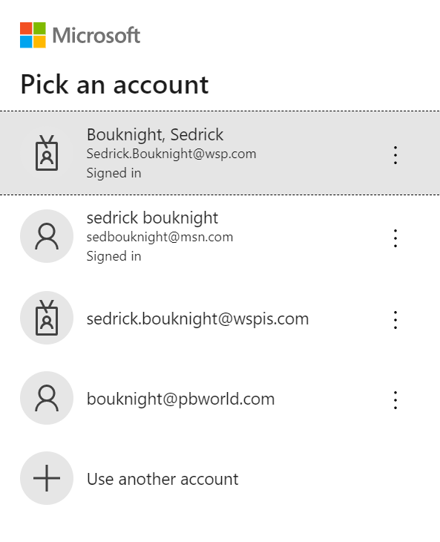
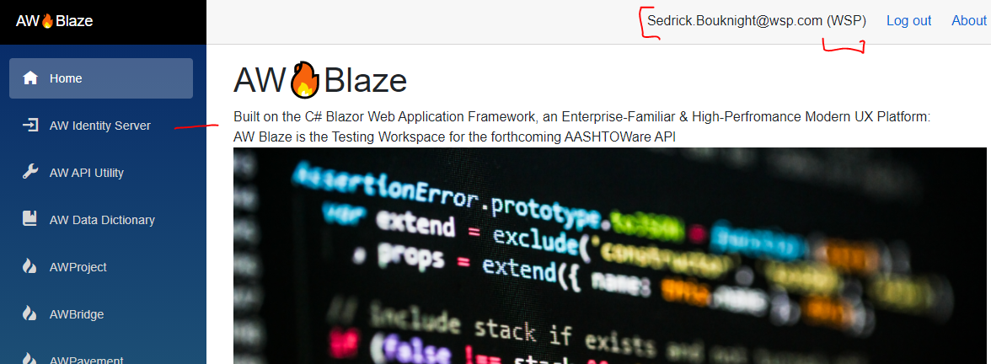
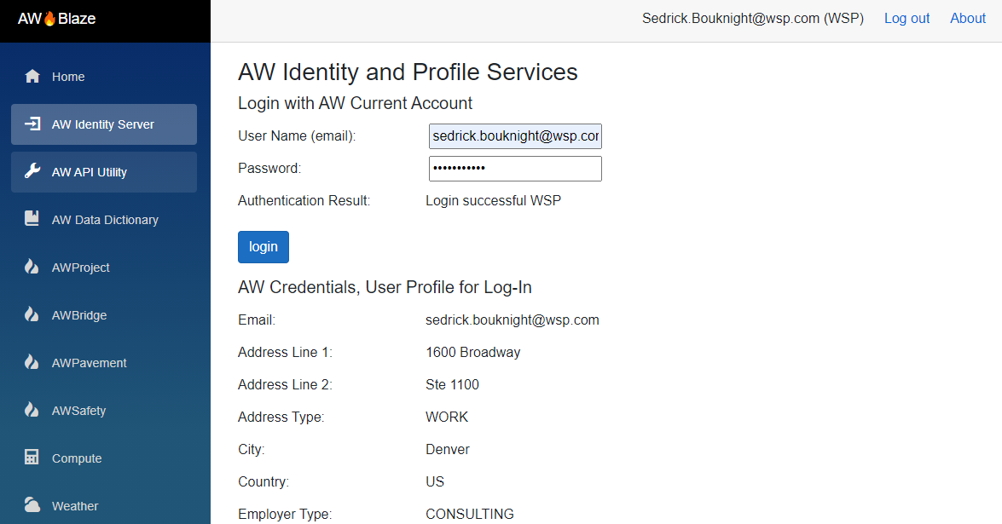
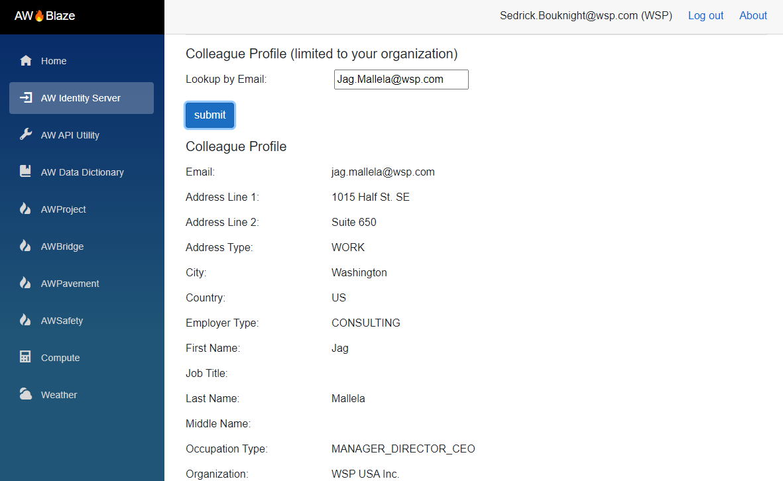
🔥
https://datalab.aashtoware.org/blaze

Slide 23
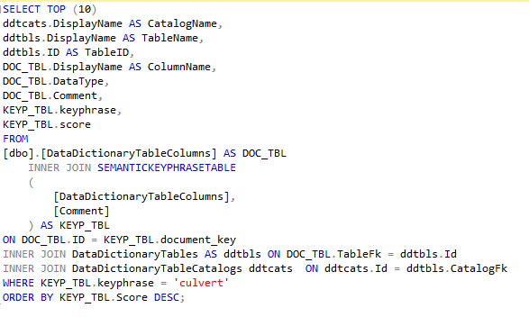
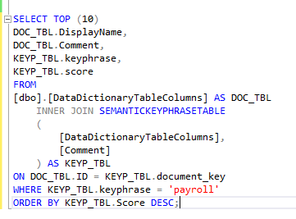
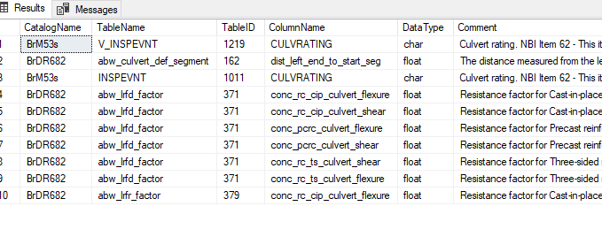
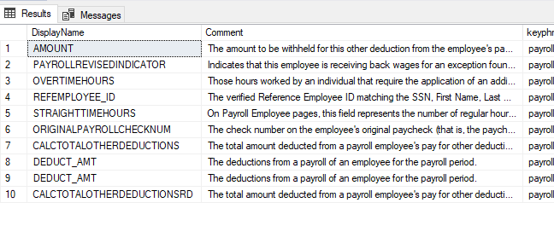
AW Blaze – Data Dictionary Extraction
Data Dictionary - Payroll
Data Dictionary - Culvert

Slide 24
Session 4 Look-Ahead
Notes:
Read-Only overlapping scenarios “common denominator” from top 17

Slide 25
Highlights for Next Session
Implementation Prelim Ramp-Up Critical Path
Revisiting Scenarios, Data Exchanges
Semantic “AI Light” Data Dictionary Search
High-Impact Scenarios, Continued
Break-Out Workgroups and Technical Engagement

Slide 26
Questions & Answers

