Slide 1
AASHTOWARE DATA INTEGRATION FRAMEWORK Phase 2 – Session 5
Review Session
March 25th, 2021

Slide 2
Today’s Session will be Recorded

Slide 3
AGENDA
1
Introduction & Session 4 Recap
2
System Foundations
3
Initial Implementation Ramp Up
4
Data Exchanges
5
Addressing & Generalizing High Impact Scenarios
6
Lab Exercise 5: API Management, Swagger Collaboration, Implementation Tooling Preview
7
Technical Engagement – “Marco | Polo” Proof of Concept
8
Next Session Look-Ahead
9
Q&A, Close Out

Slide 4
Session 4 Recap

Slide 5
Session 4 Takeaways
All foundation design “better practices” are complete
Iterative changes moving to v1.0 are rule-aligned
Data manipulation is tied to query/read operations
High-Impact scenarios cross product/system lines
API design reflection an open spec. but is not open
AW API is not public
AW API is protected
AW API design includes governance & management concerns
Design process involves a spectrum of tooling/utilities
Implementation Prep – First Steps

Slide 6
Clean Slate, Green-Field: Evolution 1
Application
Application
Application

Slide 7
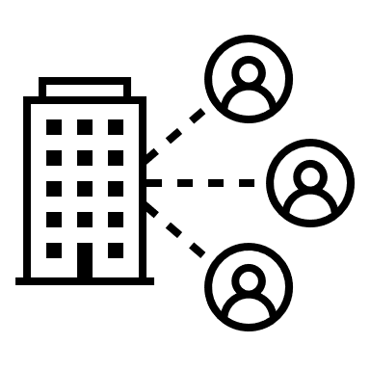
Evolution 2
Application
Application
Application

Slide 8
Evolution 3

Slide 9
Current Approximation
Application
Application
Application
Application

Slide 10
First Steps
Financial Sys
AW Project
Application
AW Bridge
AW License
Application
Gov Sys
GIS Sys
AW Safety
AASHTOWare API
Application
AW Pavement
AW Future

Slide 11
Data Exchanges
Multi-step processes across product systems
Well defined, batched, resilient
Potential for high utilization
Complex orchestration
Composite processes
On-Behalf-Of Credential “Hop”

Slide 12
Baseline Constraints – High Impact Scenarios
Data repositories will be distributed
The API design will serve as a brokering template
The API design incorporates implementation and operational concerns: designing towards usage
High-impact scenarios are not a discrete feature list
The high-impact scenarios direct a path of functional coverage around overlapping aspects
Without broad coverage, utility reuse is not maximized

Slide 13
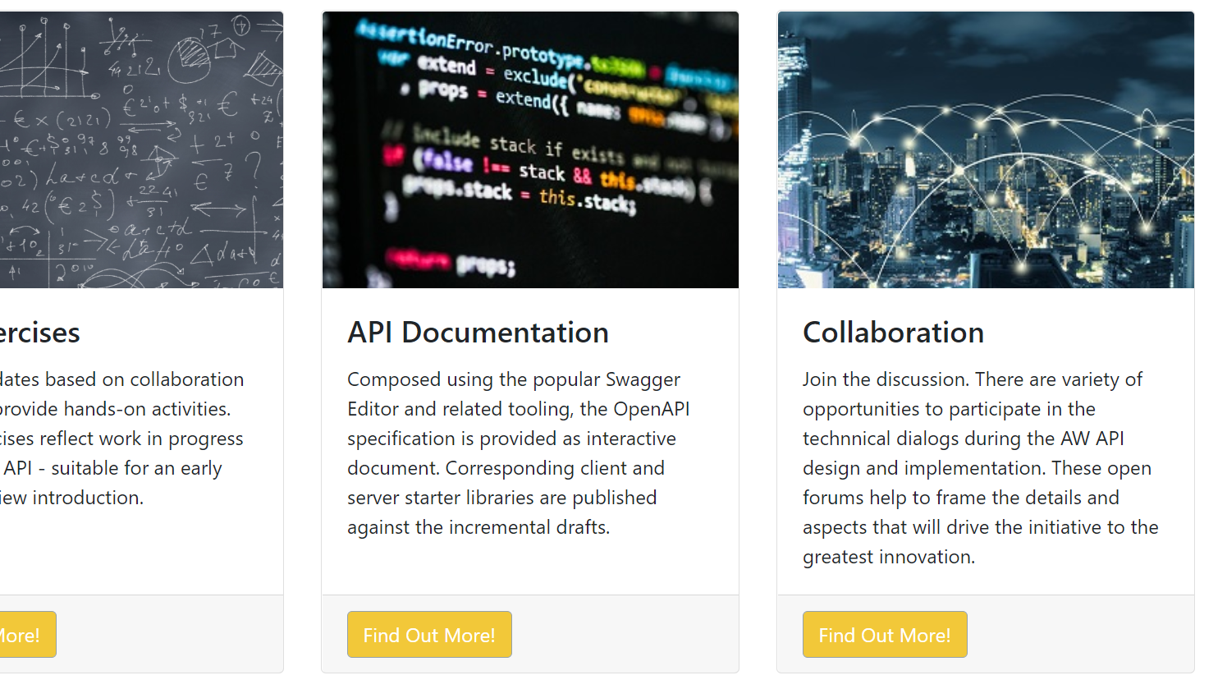
AASHTOWare Data Lab DataLab.AASHTOWare.org
Notes:
Reminder on lab portal address

Slide 14
Slow Motion Replay

Slide 15
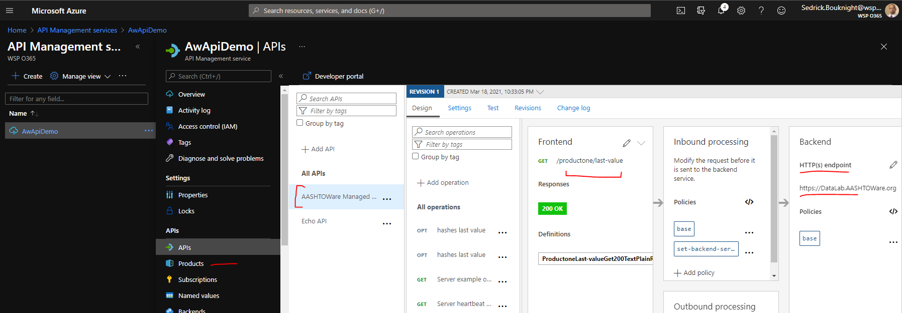
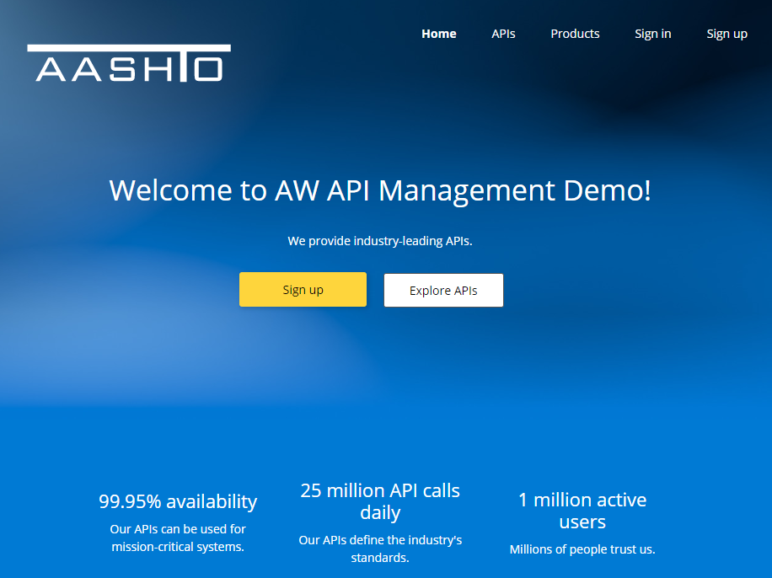
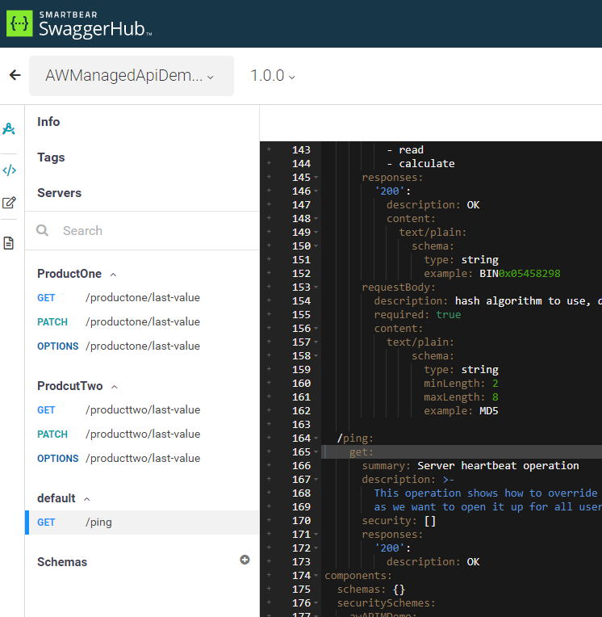
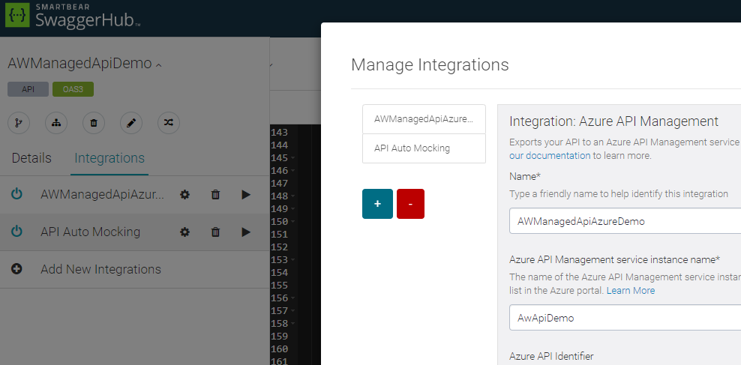
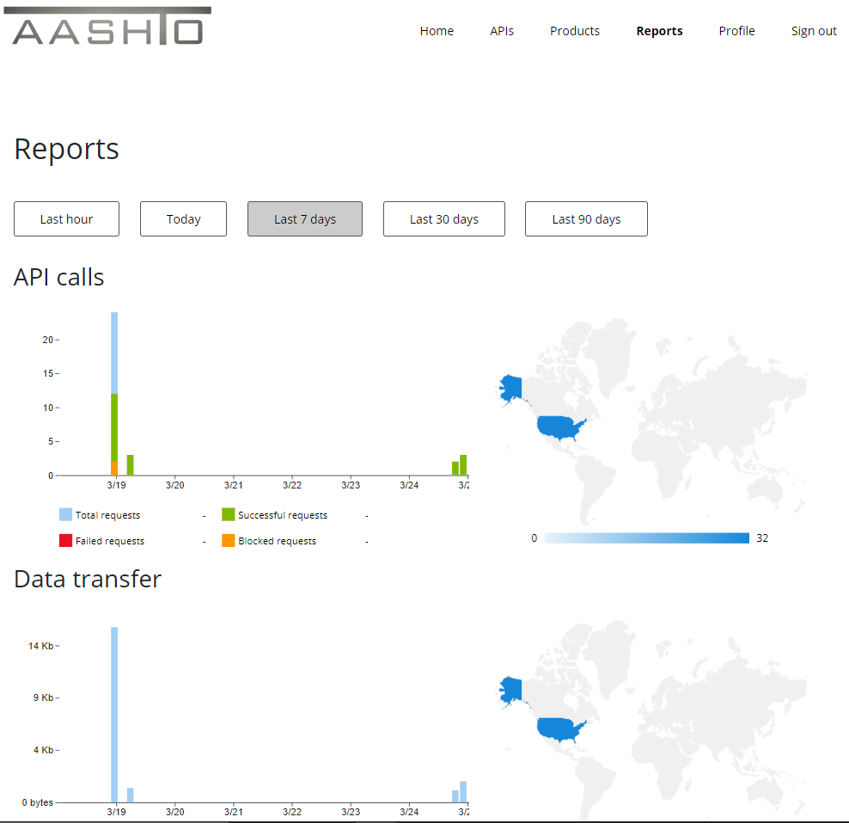
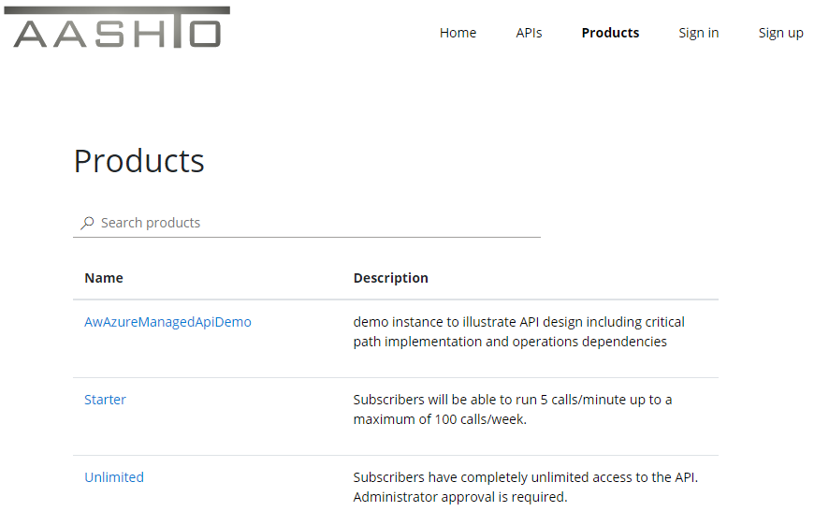
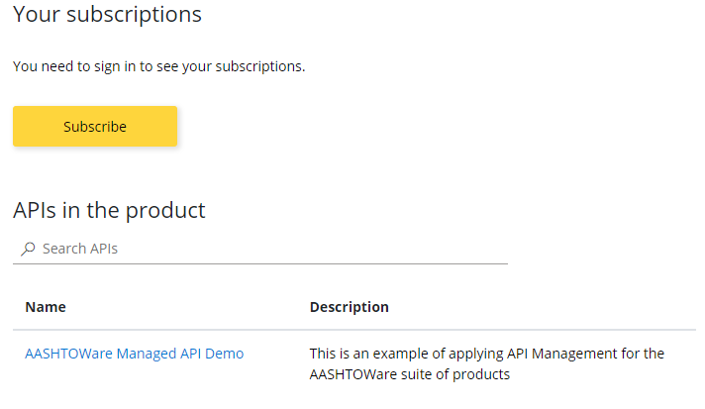

Slide 16
Establishing a Baseline: “Marco … Polo”

Slide 17
Next Steps
Distributed implementation of test API
On-Behalf-Of Credentials Baseline
Opening Swagger Hub to (schema) comments by product
Configuration of API Management Framework
Exchange of product vLatest (bits, schema, docs)
Packaging of custom tooling for implementation support

Slide 18
Session 6 Look-Ahead
Notes:
Read-Only overlapping scenarios “common denominator” from top 17

Slide 19
Highlights for Next Session
Implementation planning
Swagger Hub schema collaboration
Custom tooling “static analysis” results, refresh
High-Impact scenarios 90% complete (coverage)
Implementation “Marco Polo” results

Slide 20
Questions & Answers

