Slide 1
AASHTOWARE DATA INTEGRATION FRAMEWORK Phase 2 – Implementation Workshop Intro
Review Session
May 6th, 2021

Slide 2
Today’s Session will be Recorded

Slide 3
AGENDA
1
Meeting Goals, “Around the Room” Quick Introductions
2
API Management as Infrastructure
3
API Design Container – Instance Concept
4
Target Operating Model: AW Product API Path ‘Roots’
5
Resource Aspect vs Query Aspect – Translating from OData
6
Schema Segmentation by AW Product, Composition, Discriminators, Extensions (customization)
7
AW API Design Patterns
8
Next Session Look-Ahead, Lead Contacts by Product
9
Q&A, Close Out

Slide 4
Implementation Ramp-Up Focus

Slide 5
Meeting Goals: Ramp-Up Prelude
Introductions, overview of platforms in use, efforts underway
Demystifying data barriers and interoperation
Configuration aspect of “one api” driven by multiple distinct systems
Differentiate between prior integration efforts and how to leverage for long term objectives
Active/Preferred tool suites: Automation, Generation, Mapping, Translation
Collaborative “Hello World” against the API Management Platform

Slide 6
Around the Room
Please Introduce Yourself/Team
Current Primary Development Platform/Stack
Active API/Service Projects
API Planning, Outlook, Roadmap
Near Term (Related) Opportunities and Challenges

Slide 7
Implementor Role Expectations
Designate a primary lead collaboration contact
1
Schedule one-on-one technical design and work planning session
2
Determine a wish list of devOps points, specs, and code accelerators for API implementation tasks
3
Delegate a technical lead for a “Hello World” prelim mobilization exercise
4
The API Data Lab includes cloud resources for each AW Product: this will facilitate the coordination & verification

Slide 8
The Big Picture
The API design effort is inclusive across all concerns
Implementors take over at the product-level dev work
Each component, convention, and framework aspect is geared towards APIs-as-a-product long-term solution
The emphasis is toward a multi-use, multi-function capability suite VS a portfolio of single function integration projects
Intended API capability coverage is towards for application parity
This opens opportunities to a completely new developer, partner, and technical community for AASHTOWare

Slide 9
API Design → Implementation: Management
Prepare
Uniform, universal, single control point for AW API
Offload & consolidate
Offload & consolidate API configuration management
Plan
Support multiple disparate endpoints
Support
Support multiple “installation” modes (on-prem/cloud)
Simplify
Eliminate product-specific ops concerns
Steward
Address aggregate monitoring, usage, access
Foster
Provide industry-familiar developer/partner experience
Extend
Allow “build once”, compose often extensibility
Unify
Align non-AW integrations under a common framework

Slide 10
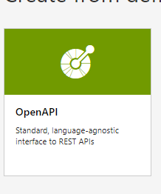
Disparate Operations, Installations: Hard, one-Offs
Application
Application
Application
Pavement External Scenario

Slide 11
API Management Gateway – New, Easy
*Consumer:
Uses the API
-DOT/Agency
-3rd party Devs(Autodesk)
-ISV as Integrators
*Supplier:
Provides API
Implementation (AW ‘devs’ creators)
-AW Bridge (team)
…
-Build to Our WSP API Spec
AASHTOWare API
AW Project
AW Pavement
AW Licensing
AW Safety
Installation Instance
AW Bridge
AW Pavement
Application
External Connectors
AW Future

Slide 12
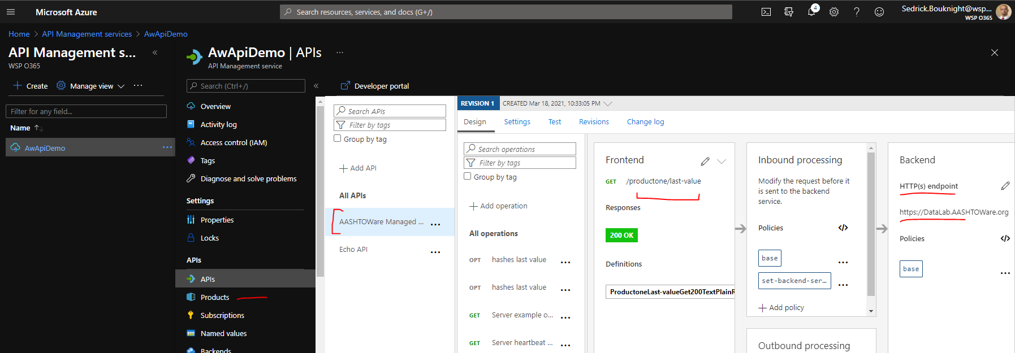
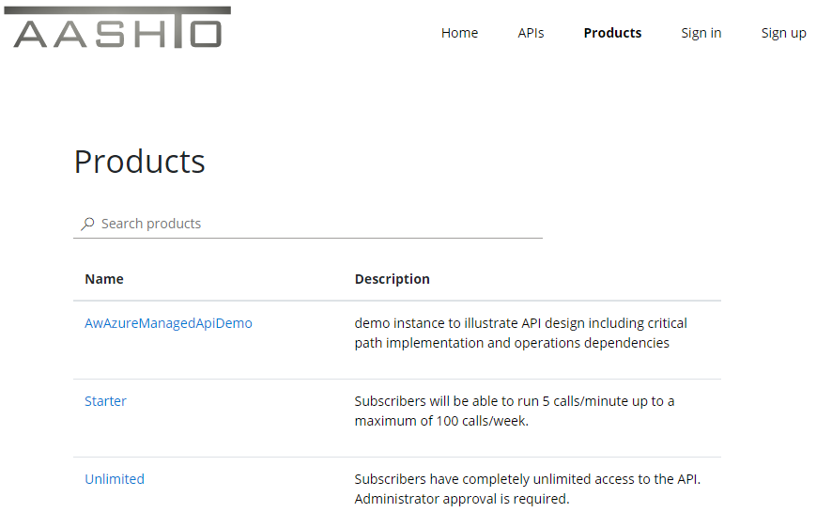
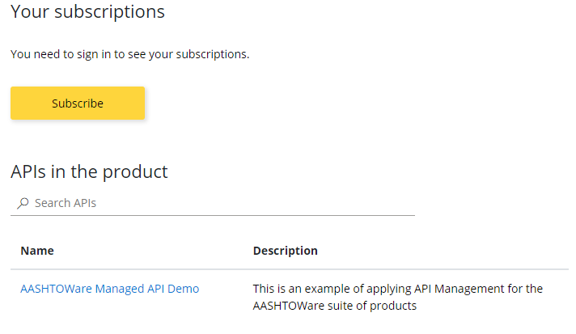
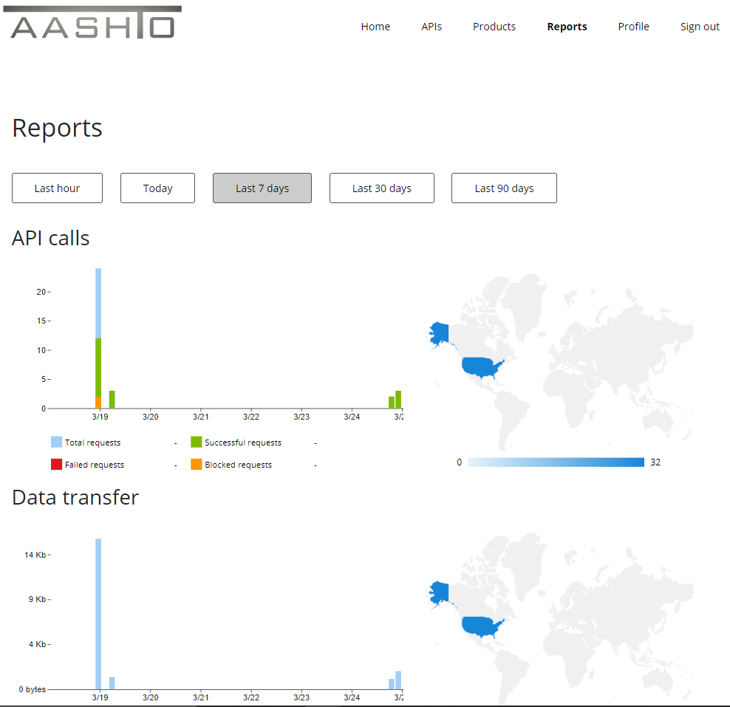
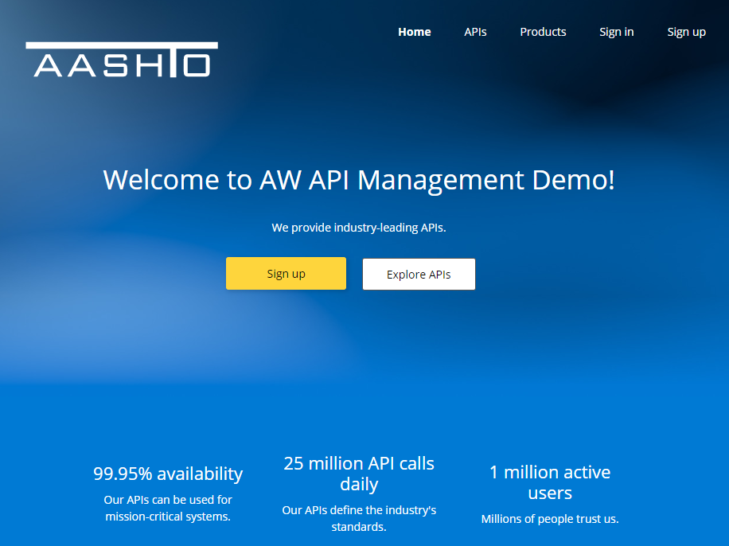
Fully Provisioned Result

Slide 13
Distinct Instances & Installations
Abstraction to supplement current real-world operations
Standard internet resolution
Cloud, on-prem, hybrid, dedicated, shared
Config management automation support
Guaranteed consistent (development) experience
No dependencies between AW Products
Complete flexibility by instance

Slide 14
What does this look like?
MyDOT Project is cloud hosted
MyDOT Bridge is on-prem
YourDOT Project is cloud hosted
YourDOT Bridge is cloud hosted
https://myDot.AASHTOware.org/api
https://myDot.AASHTOware.org/api/awproject
https://myDot.AASHTOware.org/api/awbridge
API Management Gateway allows wildcard
https://*.AASHTOWare.org/api
https://yourDot.AASHTOware.org/api
https://yourDot.AASHTOware.org/api/awproject
https://yourDot.AASHTOware.org/api/awbridge

Slide 15
Target Operating Model - Practicality
Implementation will occur by product team
There are no shared (code) artifacts between teams
There are no blocking dependencies between teams
The API design (spec) addresses all interoperability
API Management Gateway asserts API “fulfillment”
Business as usual

Slide 16
What does this look like?
https://{instance}.AASHTOware.org/api/AWProject
https://{instance}.AASHTOware.org/api/AWBridge
Delivered by cloud hosted endpoint
Delivered by internet accessible on-prem endpoint
Instance convention can be used in url-rewrite transformation by gateway

Slide 17
Variation on a Theme: Original Points
RESTful Tenents
Functional Organization
Treating data as url-addressable resources
OpenApi better-practices design methods
Structure
Self-description
Familiarity is not a perquisite for ease of use

Slide 18
OData → OpenAPI ‘Expectation’
OData, generally, is query composition focused for data retrieval
With the OpenAPI Standard, data is resolved as a uri-defined resource
RESTful behavior in terms of a web api is “baked-in” from the OpenAPI Standard
OData RESTful elements are more subject to expressions as compared to (model) structures
Why does this matter? Does it matter?

Slide 19
AW API Scope Implications
Multiple products
Multiple product teams
Multiple/Distributed installations
Schema: ~2,500+ tables | ~40,000+ columns
Parallel software/product Lifecycles
A (Potential) completely new developer/partner base
API versioning
External systems’ integration(s), often widely adopted

Slide 20
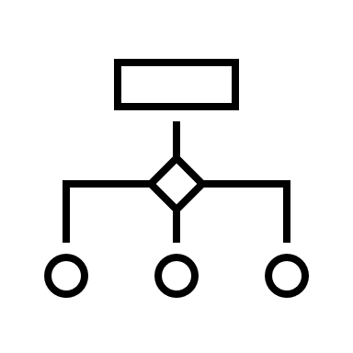
Repurposing Existing Artifacts
AASHTOWare API
Most of (your) code is already done…

Slide 21
AW API Data Model
OpenAPI Standard support for inheritance, variance
Model “ownership” (stewardship) by AW product
Shared model usage, schema segmentation
Prescriptive guidance for eventual “open” extension
Each AW Product has a fundamental and different [Project] data structure
Any of the current [Project] data definitions are useful as a “base” model to extend

Slide 22
Minimal Base Model(s) for Versioning
Global base model(s) with key attributes, including discriminator field for type variance support
Product-segmented models reference base model
Specialty derivative models reference either
API versioning to vNext allows “graduating” model properties upward
Methodology defines clear extension path, backwards, compatibility, and low friction refactoring
Model data definition structures are highly curated

Slide 23
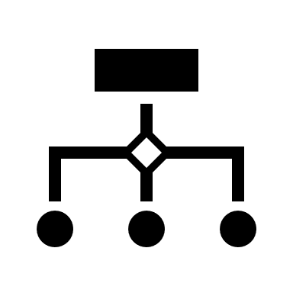
Model Composition, Property “Graduation”
Project Model Composition
Model Base, limited properties, what starts here lasts for eternity
Product-specialized properties, extends base composition
Potentially further specialty (sanctioned) extension for tailored scenario

Slide 24
AW API Design “Recipes” - General
High-Impact scenarios define a code coverage metric as compared to a static functional requirement
“Pinnacle” entities/data structures are identified within the high-impact scenarios
(Non-Recursive) Relational/Graph/Hierarchical dependencies are mapped up/out to 5 degrees
Non-Direct child pinnacle objects in that graph are eliminated, and are used in a dedicated API path
Create|Update routines for post|put|patch are constrained to the least-depth, required properties
Exceptions to the pinnacle Create|Update conventions are addressed by lightweight (fewer properties) patch actions

Slide 25
Recipes – Data Exchanges (AW or External)
The [put] verb is preferred for specialty data-modifying operations
Each step in a defined exchange is built by more fundamental “simple” existing API routines
The process is self-dependent and self-contained as it applies to the API definition
The constituent routines can (should) be should used in any other capacity as needed
Data exchanges are equally suitable for orchestration – build once reuse, eliminate one-off needs

Slide 26
Recipes – Tailored Extensions, Scenarios
Pinnacle entities allow a “soft-link” of a custom properties collection focused to instance/organization
Similar extension by provider (ESRI, SAP, …) allows the same approach with a reserved structure
The Details/Property-Sets use keyed {name, value, ordinal} assignment and option grouping qualifier
Leveraging OpenAPI co/contravariance support – a qualified inherited model is also a suitable extension
Finally, entity traversal through OpenAPI Standard links (hypermedia)
This is the basis to “project” a result set into an IFC-complaint output with a simple mapping configuration

Slide 27
Recipes – Summary, Over-Simplified
https://MyDot.AASHTOware.org/api/AWBridge/projects/12345
https://MyDot.AASHTOware.org/api/AWBridge/projects/12345/property-sets/MyDot
https://MyDot.AASHTOware.org/api/AWBridge/projects/12345/property-sets/YourDot
https://MyDot.AASHTOware.org/api/AWBridge/projects/12345/details/ESRI
https://MyDot.AASHTOware.org/api/AWBridge/projects/12345/details/SalesForce
https://MyDot.AASHTOware.org/api/AWBridge/projects/12345?transform=ifc
https://MyDot.AASHTOware.org/api/AWBridge/exchange/projects
https://MyDot.AASHTOware.org/api/AWProject/projects/12345

Slide 28
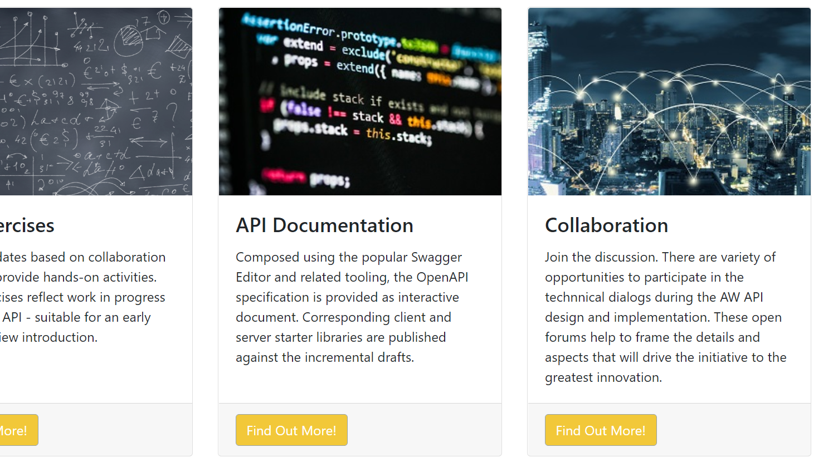
AASHTOWare Data Lab DataLab.AASHTOWare.org
Notes:
Reminder on lab portal address

Slide 29
Data Lab AW Product Endpoints: Implementation Support

Slide 30
Next Steps
Contact Leads by Product
Schema Definition Collaboration
Swagger Hub Access for Contact Leads
Lab Endpoint(s) Use
“Hello World”

Slide 31
Collaboration Planning
Notes:
Read-Only overlapping scenarios “common denominator” from top 17

Slide 32
Key Tasks, Action Items
API Design Release Preview
Utility Tooling
Test Scripting
“Auto Regenerate” API / Data Dictionary Suite
AW, non-AW, OData/DB starter
Property Mapper, Extension Tooling
API Management Requirements, Production Options

Slide 33
Questions Answers Discussion

