Slide 1
AASHTOWARE DATA INTEGRATION FRAMEWORK Phase 2 – Session 6
Review Session
June 17th, 2021

Slide 2
Today’s Session will be Recorded

Slide 3
AGENDA
1
Phase 2(A) Recap
2
Key Milestones
3
Final Foundation
4
Inventory, Toolbox, Roadmap
5
“THE” AASHTOWare API Gateway
6
Guided Tour Introduction: How to Subscribe & Why
7
Bonus Round – Data Dictionary Revisited, Tailored & External Support
8
Outreach Reboot / Coming Soon (Subscribe!)
9
Q&A, Close Out

Slide 4
Phase 2(A) Fast Retrospective

Slide 5
Back to the Big Picture…
API Design
API Implementation
API Use

Slide 6
Concept to Execution
Research
Exhaustive Scenario Definitions
Comprehensive Data Inventory
Design
Technical Conventions
Standardization & Practices Guidance
Implementation
Specialized Automated Tooling
Repurposing of Established Assets
Use
Infrastructure “Glue”
Unified Operational Support

Slide 7
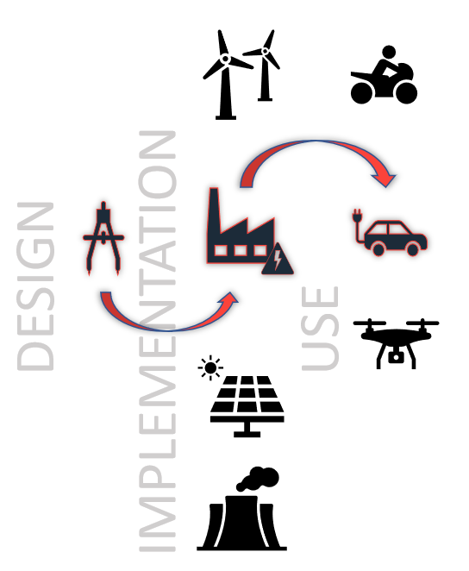
Iterative Process
Mid Point of First Cycle
Activities (Now) in Parallel
Distinctions are Preserved
Room to Evolve
Established Direction
Facilitates Opportunity

Slide 8
The Whole Process by Phase (Redux)

Slide 9
Key Milestones

Slide 10
Completed Objectives
Translate
Translate Initial Research into Tangible Artifacts
Establish
Establish, Adopt (Embrace), Contemporary Methods
Apply
Apply a Practical and Comprehensive Design Approach
Define
Define Technical Conventions, Provide Automation
Address & Eliminate
Address & Eliminate Execution Barriers Early

Slide 11
Final Foundation

Slide 12
A Platform Launchpad
Prescriptive technical guidance to ensure consistency
An industry “familiar” design using the OpenAPI Standard
A “Build Once, Use Often” methodology for composition
A set of robust tools to facilitate and automate implementation tasks
A comprehensive operations and management platform to accelerate delivery

Slide 13
Inventory

Slide 14
Final Results
“High Value” defined data easily accessed from API
“High Impact” data exchanges achieved with a means to extend across products and external offerings
Automation of extending the API data delivery scope
Extension & Inclusion of data concerns by agency or third-party system
“Non-Invasive” (low disruption) path to implementation
Commercial-Caliber essential infrastructure for delivery

Slide 15
How it Comes Together, Over-Simplified
https://MyDot.AASHTOware.org/api/AWBridge/projects/12345
https://MyDot.AASHTOware.org/api/AWBridge/projects/12345/property_sets/MyDot
https://MyDot.AASHTOware.org/api/AWBridge/projects/12345/property_sets/YourDot
https://MyDot.AASHTOware.org/api/AWBridge/projects/12345/details/ESRI
https://MyDot.AASHTOware.org/api/AWBridge/projects/12345/details/SalesForce
https://MyDot.AASHTOware.org/api/AWBridge/projects/12345?transform=ifc
https://MyDot.AASHTOware.org/api/AWBridge/exchange/projects
https://MyDot.AASHTOware.org/api/AWProject/projects/12345

Slide 16
The API Gateway

Slide 17
All Products Hosted Together, One Data Lake
Application
Application
Application

Slide 18
Reality
Disparate installations
Instance/Installation specific tailoring
Multiple product teams
Various hosting modes

Slide 19
AW OpenAPI & API Management Gateway
Full Technical Specification for Implementation
Fully Commissioned Operational Infrastructure
Prescriptive Guidance for Extension or Enhancement
Breadth of Supports to Cultivate Dev/Partner Community
Unification of Key Practices with Insights

Slide 20
API Management Gateway
AASHTOWare API
AW Project
AW Pavement
AW Licensing
AW Safety
Installation Instance
AW Bridge
AW Pavement
Application
External Connectors
AW Future

Slide 21
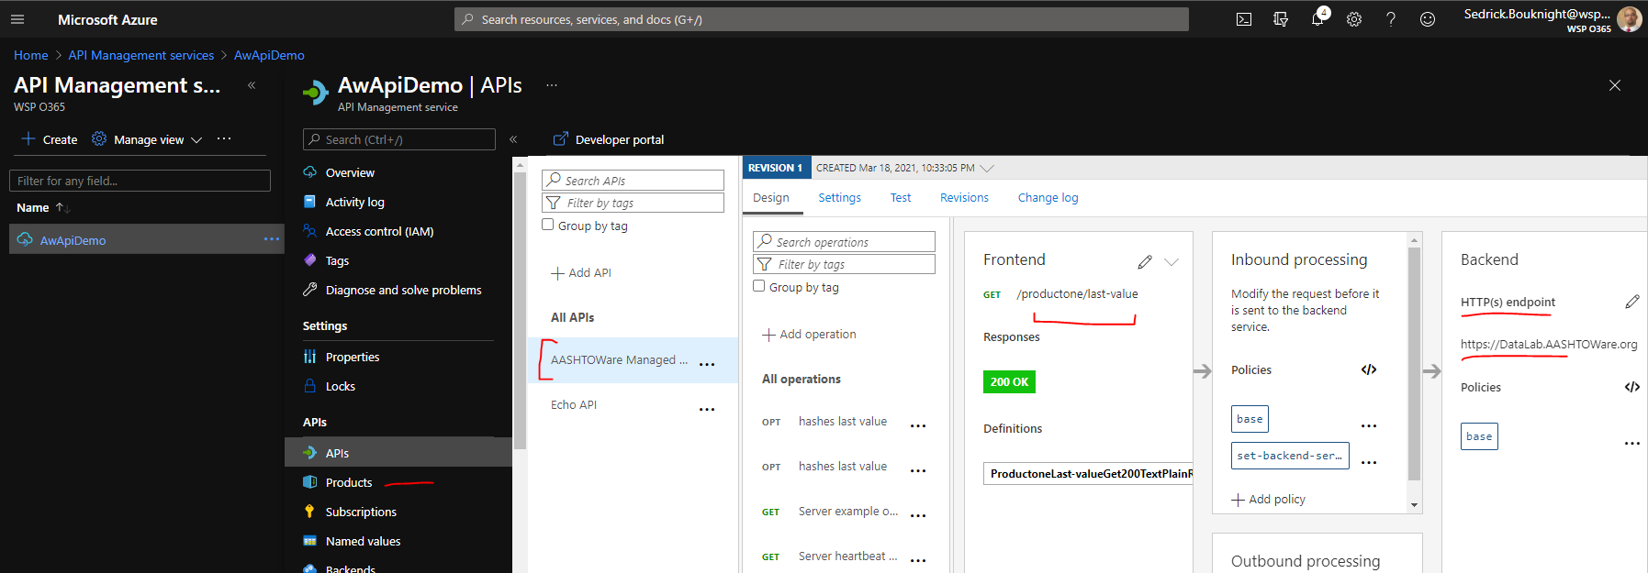
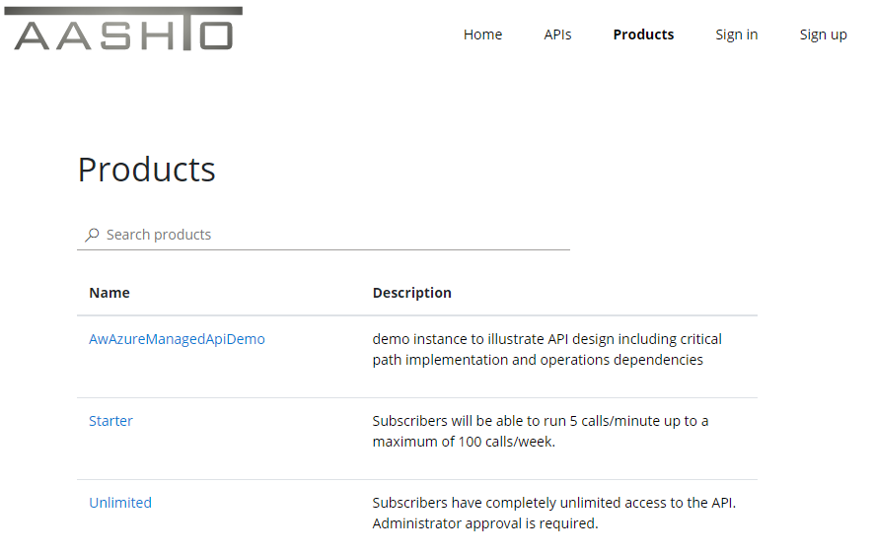
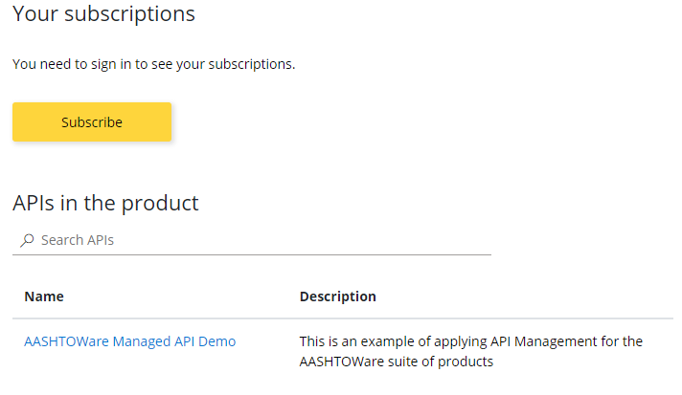
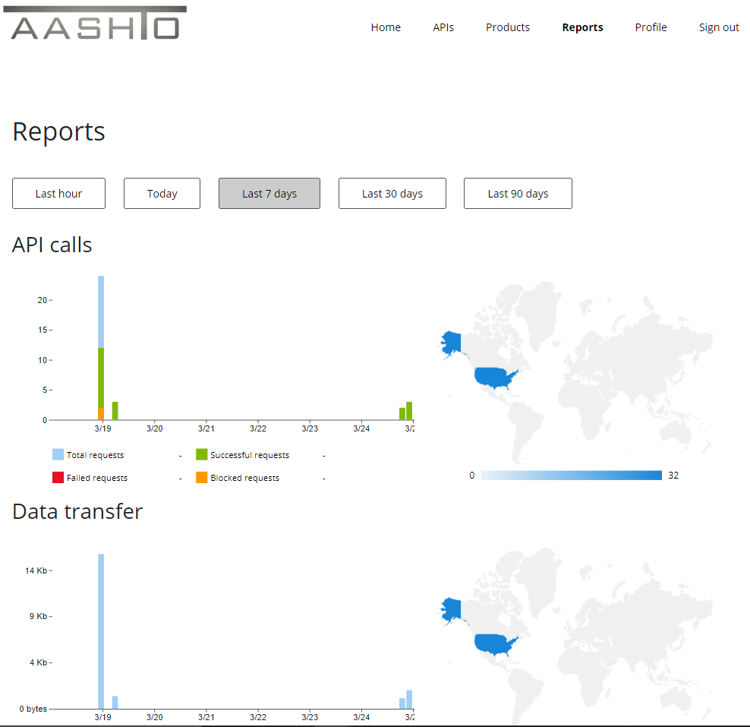
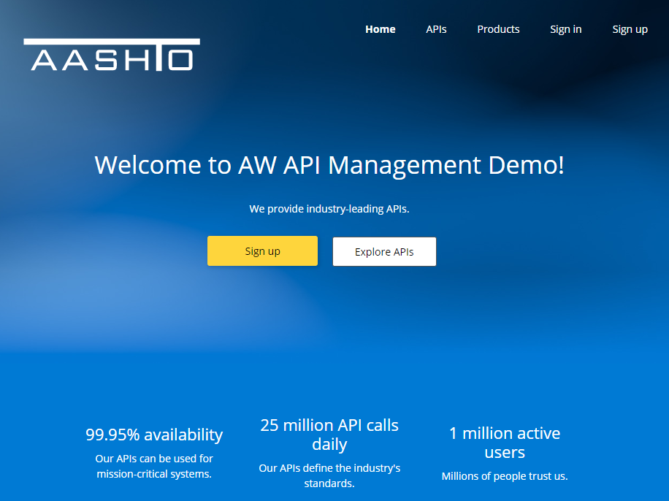
Now Live!

Slide 22
Guided Tour
Notes:
Read-Only overlapping scenarios “common denominator” from top 17

Slide 23
Extension to the DataLab Portal
Access
Prototype
Technical Samples
Simulation
Same Destination for “Live”

Slide 24
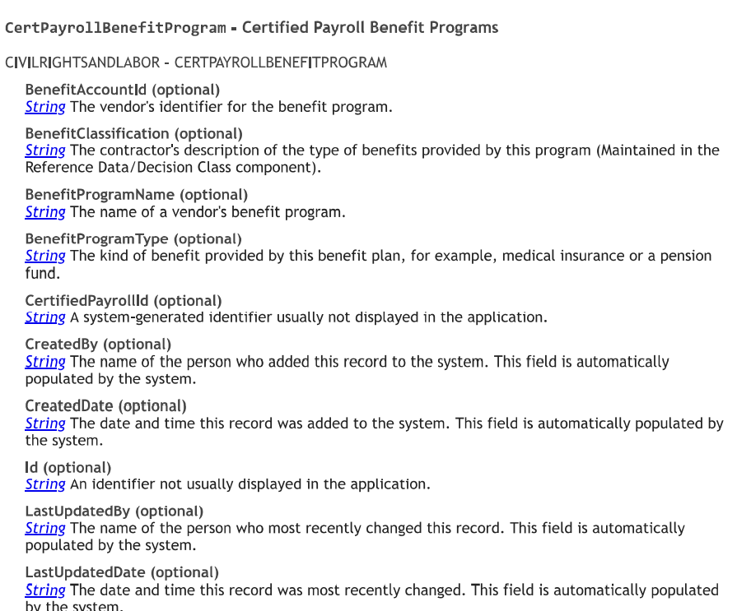
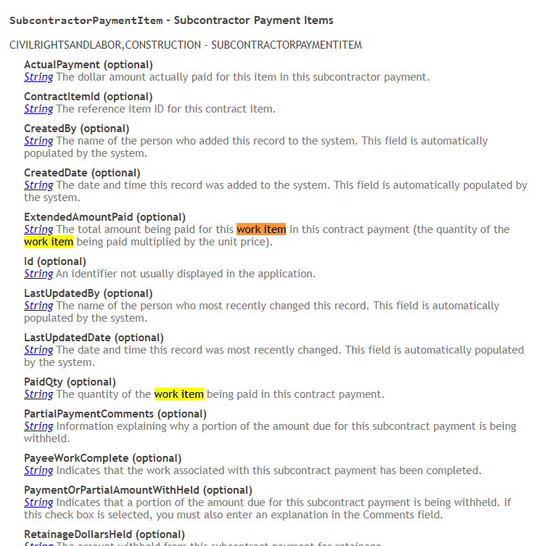
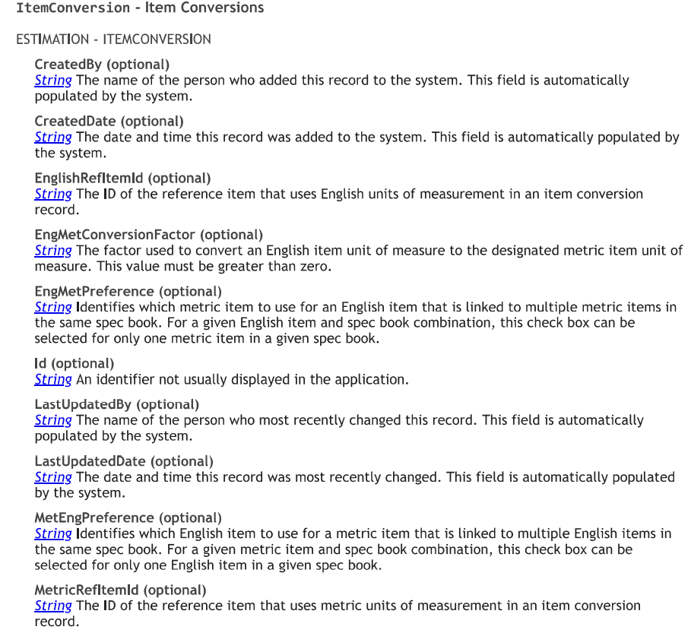
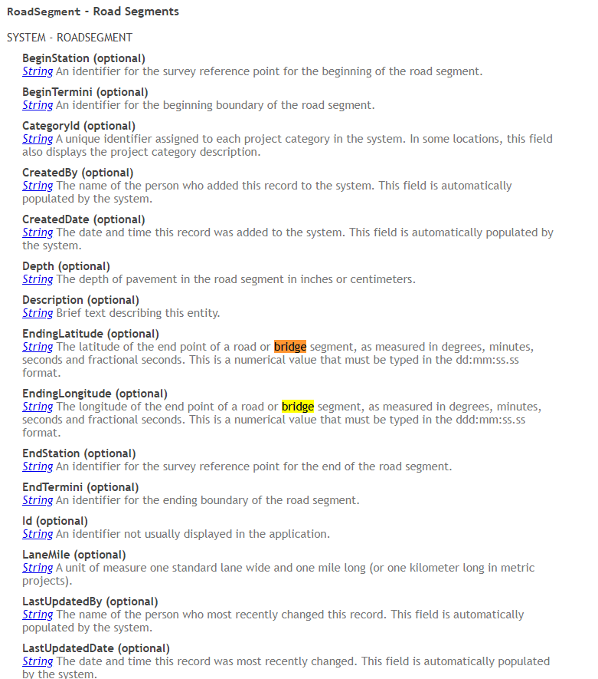
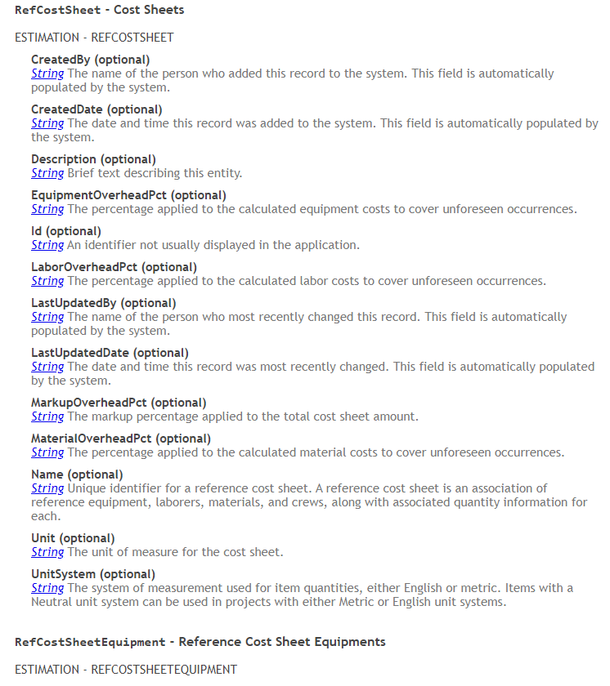

Slide 25
AASHTOWare Open & Extensible Modern Platform
Notes:
Read-Only overlapping scenarios “common denominator” from top 17

Slide 26
API Design → Implementation: Management
Prepare
Uniform, universal, single control point for AW API
Offload & consolidate
Offload & consolidate API configuration management
Plan
Support multiple disparate endpoints
Support
Support multiple “installation” modes (on-prem/cloud)
Simplify
Eliminate product-specific ops concerns
Steward
Address aggregate monitoring, usage, access
Foster
Provide industry-familiar developer/partner experience
Extend
Allow “build once”, compose often extensibility
Unify
Align non-AW integrations under a common framework

Slide 27
What’s Next – Let’s Go!
Implementation
Outreach Continued / Coming Soon / Mobilization & Ramp-Up
Task Force Coordination
Vendor Starting Point
Defining the Developer/Partner/Audience API Community
Stakeholder Dialog (Strategic Goals)
New High-Impact Scenarios
External “Shareable” Integration Projects
New Opportunities – High Performance Compute, AI, Research

Slide 28
Questions & Answers

